Slide 1

Welcome to Year One

Slide 2

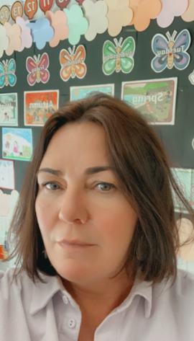
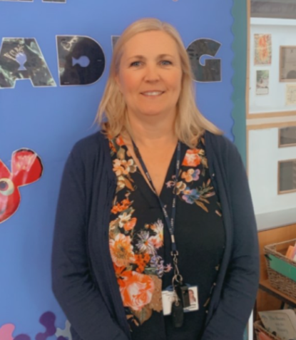
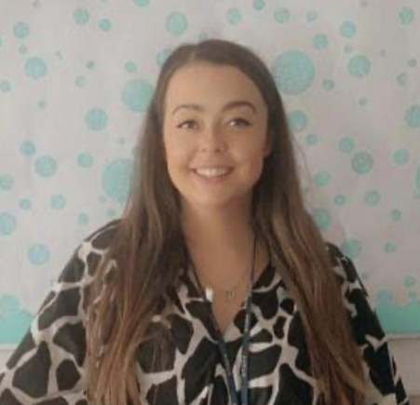
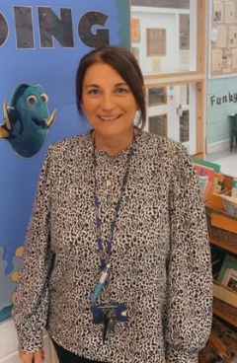
The Year One Team
Mrs Edwards
Mrs Crummey
Mrs Neil
Miss Fitzgerald
Mrs Wood
Miss Carla

Slide 3
Attendance Matters At Emmaus
Please ensure your child arrives for school on time
Telephone school if your child is to be late
For routine non-emergency medical and dental appointments please ensure they are
made outside of school hours
Contact school preferably by 10.00 am on the first day of absence if your child is unable to attend through illness, giving an indication of the expected duration and return date to school.
If a text message/phone call is received as a result of your child’s absence it is important that you respond to this text to ensure your child is appropriately safeguarded.
Contact Mrs Hope (Attendance Lead) or Mr Williams (Headteacher) if the reason for absence requires a more personal contact.
Holidays in term time will not be authorized and will result in a fine

Slide 4
Mission Statement
School Values
Generosity
Compassion
Courage
Forgiveness
Friendship
Respect
We are friends journeying with Jesus in faith, hope and trust as we live, love and learn together.

Slide 5
Reading is everything at Emmaus
Our aim is to ensure that every child becomes a fluent reader.
The Top Ten Benefits of Reading for Children
Their vocabulary is larger and more extensive.
They perform better academically.
Their imagination can run wild.
Their creativity skills develop.
They develop empathy.
They gain a deeper understanding of their world.
Their concentration levels improve.
The parent and child bond improves.
Their cognitive development is supported.
Their social skills and interaction improve.

Slide 6
Reading is everything at Emmaus
How Parents Can Read with Their Child
If you read with your child at home, then you are supplementing what they learn in the classroom as well as giving them additional one-on-one support that the classroom cannot always give.
To have successful and effective reading sessions, consider the following:
Make it part of your routine.
Encourage variation of books.
Have patience with your child.
Continue the discussion after you have read the story.

Slide 7
Behaviour policy
Key stage 1 and 2
Verbal warning
Name on board
Cross beside name and 5 mins playtime gone
Cross beside name, playtime lost, sent parallel teacher
Senior leadership member and parents contacted by SLT and parents contacted by SLT member

Slide 8
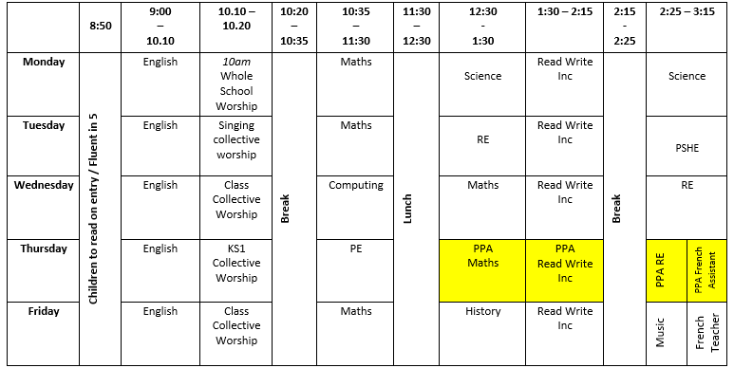
Read Write Inc, English and Maths

Slide 9
Timetable
1E
PE is on a Monday morning.
1F
PE is on Wednesday morning.

Slide 10
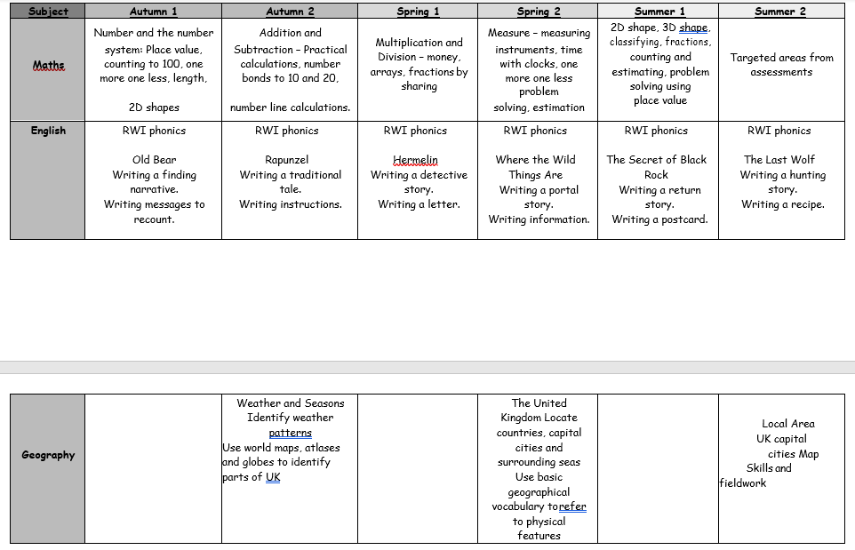
Topics

Slide 11
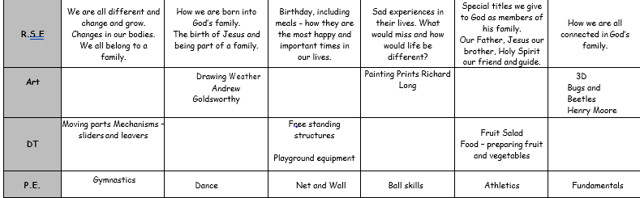
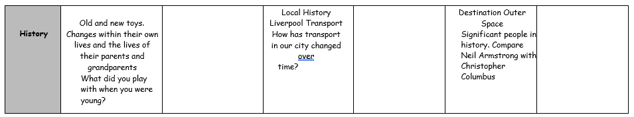

Slide 12
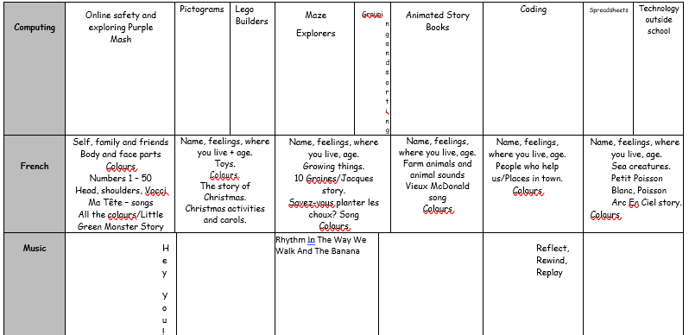

Slide 13
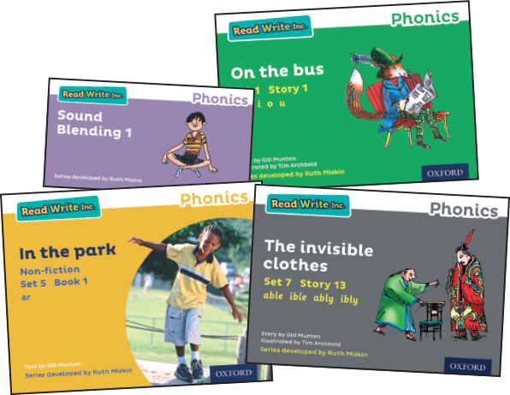
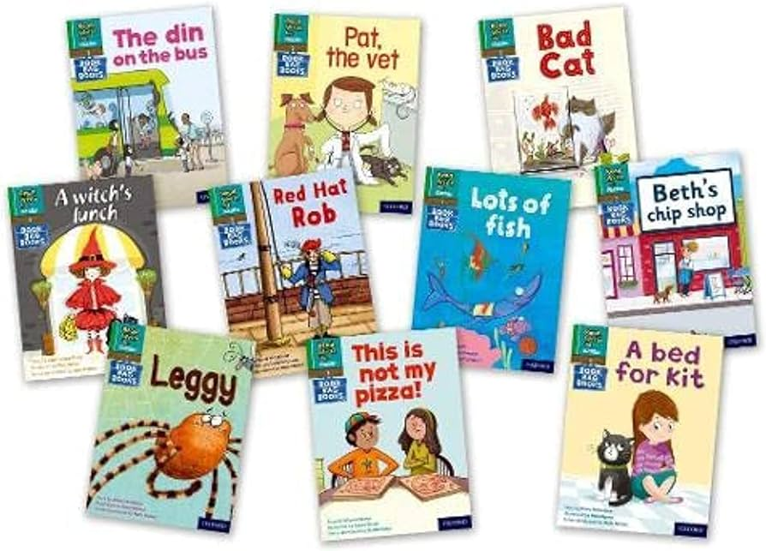
Reading
As you are already aware, the infant reading scheme is RWI. Your child will bring home two types of book each week.
Black and White Storybooks
This is a copy of the colour version read at school.
Your child will have read this story three times with their reading teacher, so should be able to read the story confidently.
A brief explanation of how to follow the activities is included in the books.
Book Bag Books
Your child may also bring home a Book Bag Book.
This book builds upon the ideas and many of the words in the Storybook just read.
Your child will need more support in reading this book.
We want reading to be an enjoyable experience for the children at home. We also want to foster habits of recreational reading in the children and develop confidence and fluency. For this reason, the reading book from the RWI scheme your child takes home should be a book that the child can read independently.

Slide 14
Uniform and PE kits
You are all aware of the school uniform but we do appeal that you label each item of your child’s clothing. Finding lost cardigans and jumpers is a nightmare when they are not labelled!
It is essential that your child have a pair of pumps that fit correctly for P.E. We send home the kits each half term so that they can be washed and that you can check your child’s pumps still fit them. Please label everything in your child’s PE bag as the items sometimes get mixed up.
Please supply your child with a spare set of underwear and socks in a labelled plastic bag and place it inside their P.E. bag. If you have larger items of clothing (jumpers, pumps, shorts etc) you would like to donate please give them to the class teacher and we will add them to our spare clothes stock.

Slide 15
Homework
Reading books will be sent home everyday for reinforcement they may have the same book for a few days. Please get into the habit of sending the books back each day.
You will get an exercise book sent home on Friday which will need to be returned on Wednesday. Homework gets marked on Wednesday so it is very important to send it in.
You will get mathematics, English and sometimes topic homework.
We will send homework sheets that you will need to stick into their book, please use a glue stick rather than cello tape. We will do the first week for you as an example. We would be grateful if you could put the date on the sheet.
Please guide your children with the homework and don’t do it for them.

Slide 16
Healthy School
As you know, our school has a ‘Healthy Schools Award’ which allows each child to have a piece of fruit daily. Please let us know if your child is allergic to any fruit or if they have a problem eating fruit.
Children are welcome to bring a healthy snack to school, such as dried fruit, raisins or healthy snack or cereal bars which they can eat at snack time.
If your child brings in a snack from home, please put this in a small labelled food bag rather than in a packed lunch bag – this can be confusing!
In addition, children may take a bottle of water (not juice) to school to have at snack time if they do not drink milk. Please ensure this drink is not fizzy and that it is in a bottle with a ‘pull up’ opener and not a flask.
Please label all drinks and snacks with your child’s name.
Please do not bring snacks in that contain nuts as there are a number of children with sensitive allergies.

Slide 17
Y1 Statutory Assessment:
Phonics Screening Check
All schools in the UK are required to complete the Check with all Year 1 children in June 2024. This check will be administered by your child’s teacher.
The children are asked to read 40 words divided into 2 sections of 20 words. Both sections contain a mixture of real words and pseudo-words (nonsense-words). The pseudo words are included because children cannot read them using their memory of vocabulary so they have to use their phonic decoding skills.

Slide 18
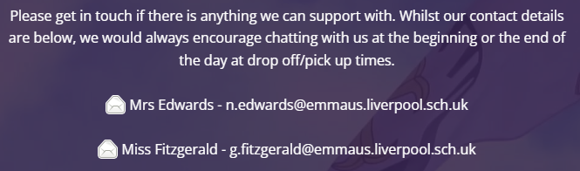
Contact with teachers

