Slide 1







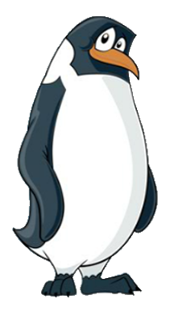






EYFS-A
The Adventures of Smartie the Penguin

Slide 2













It was late at night and Smartie the Penguin was WIDE awake...
He was too excited to sleep, because tomorrow was his birthday. He was hoping to be given a new tablet!

Slide 3















The big day came and Smartie had really enjoyed his birthday party. He had saved his most exciting looking present until the end.
“I really hope this is a tablet of my own!” he thought, as he began to open it.

Slide 4


Smartie tore off the wrapping paper in a hurry! Mummy and Daddy Penguin had bought him a brand new tablet. It was just what he wanted, and he was so happy.
Oh! Thank you, thank you, thank you!

Slide 5



Smartie’s parents explained that Smartie would be allowed to play on his tablet once in the morning and once in the afternoon. Mummy Penguin helped Smartie to get online and he was off!

Slide 6



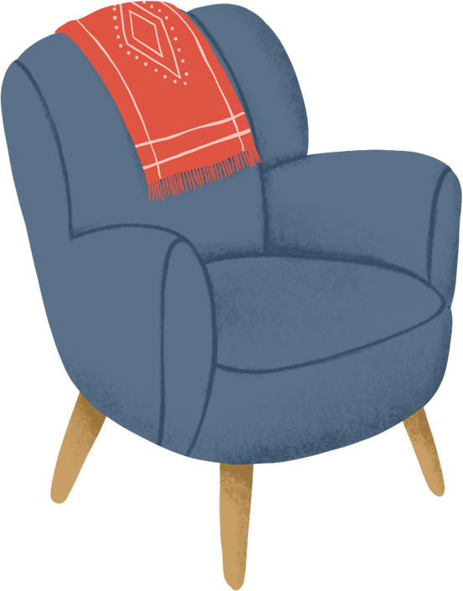


Smartie was having a great time and decided to use the internet to find out about whales. He was fascinated by them! But, when Smartie tapped ‘search,’ the first picture he saw was scary and he didn’t like it at all.

Slide 7



“Oh no!” thought Smartie, feeling afraid. “I don’t want to see this! I hope Mummy and Daddy won’t think I’ve searched for this. I don’t know what to do!”
Oh no! What should I do?

Slide 8


Can you help Smartie make the right decision?
Should he try to fix the problem by himself and get rid of the picture, or should he ask his parents for help?
Time to chat!

Slide 9


“Help!” cried Smartie. “Daddy, Mummy, please help me! Something scary has happened. There’s a picture on my screen and I don’t want to see it.”
HELP!

Slide 10
“Well done, Smartie,” said Daddy Penguin.
“You made the right choice by asking for help and not trying to fix it by yourself.”

Slide 11





Mummy Penguin was so pleased with what Smartie had done, she taught him a song to help remind him of his sensible decision, so that he would continue to ask for help in the future.
Before you tap and click…
You need to stop and think…
And TELL someone!
Sing with me!

Slide 12

Mummy Penguin deleted the picture that had popped up and changed the settings on the tablet, to help make sure that Smartie would only see pictures that were right for him.
Thank you, Mummy!

Slide 13






The next morning, Smartie rushed downstairs to play on his tablet. Daddy Penguin was already up, cooking breakfast in the kitchen.
Smartie went on to the internet and typed in, ‘All about polar bears.’
All about polar bears

Slide 14




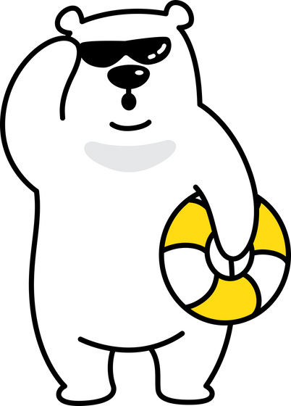

Smartie tapped on the first website, but it was very confusing! It said that polar bears live on the beach, but Smartie was sure they liked the cold weather, just like him.
Smartie thought that everything on the internet was true, but this didn’t sound right. He was feeling very puzzled.
NEWS NOW
Beach loving polar bears!
↓ READ MORE ↓
Polar bears are ditching the cold for the sandy shores! Jaw-dropping images have emerged of these majestic creatures lounging on sun-kissed beaches. 🐾🌊 #TropicalBears #UnchartedTerritory #BeachLife"

Slide 15
What should Smartie do?
Should he believe what the internet says, or should he ask for help to find the right information?
Time to chat!

Slide 16
Let’s help Smartie to make the right decision by singing Mummy Penguin’s song!
One, two, three…
Before you tap and click…
You need to stop and think…
And TELL someone!
Sing with me!

Slide 17
“Help!” shouted Smartie. “Mummy, Daddy, please help me. I’m trying to find out more about polar bears, but the information doesn’t sound right!”
HELP!

Slide 18
“Smartie,” replied Mummy Penguin, “You made a fantastic choice! Not everything online is true, so it is always best to check with a grown up first.”
Mummy Penguin helped Smartie to find the right information and everything was fine again.
All about polar bears

Slide 19





Later on that afternoon... Can you guess what Smartie was doing?
That’s right! Smartie was back on his tablet playing his favourite game, Snowcraft. He was getting better and better and trying to beat his top score from yesterday.

Slide 20









All of a sudden, the tablet beeped, and a message appeared on the screen. Another player was trying to talk to Smartie. Smartie felt quite excited.
SNOWCRAFT
HI! WHAT’S YOUR NAME?

Slide 21

The other player continued to talk. “Where do you live?” they asked. Smartie wanted to reply because he wanted to be friendly. But he was also beginning to feel worried.
SNOWCRAFT
HI! WHAT’S YOUR NAME?
WHERE DO YOU LIVE?

Slide 22
What should Smartie do?
Should he reply to the message and talk to the other player, or should he tell Mummy and Daddy instead?
Time to chat!

Slide 23
Let’s help Smartie to make the right decision by singing his special song!
One, two, three…
Before you tap and click…
You need to stop and think…
And TELL someone!
Sing with me!

Slide 24
“Daddy, Mummy!” called Smartie.
“Someone is trying to talk to me, and I don’t know them. What shall I do?”
Daddy, Mummy!

Slide 25
“Oh Smartie, coming to tell us was such a sensible choice,” said Daddy Penguin.
Well done, Smartie!

Slide 26
“If you’re not sure about somebody who is talking to you, or they make you feel worried, then always tell us. Not everybody tells the truth on the internet, and because you haven’t met this person face to face, they are still a stranger.”

Slide 27

“We can block this player, so they can’t talk to you again.”

Slide 28


From that day on, Smartie always knew how to be safe when using his tablet and playing on the internet! If anything happened that made him feel worried, upset, or confused, he didn’t try to fix things by himself.
and always asked an adult for help.
He stopped…
thought about what to do…

Slide 29

I am very lucky because I have Mummy and Daddy Penguin to help me!
But who can help you?
Time to chat!

Slide 30
Sing with us!
Before you tap and click…
You need to stop and think…
And TELL someone!

