Slide 1

On this Day in History...

Slide 2
Edition 1: 29th November

Slide 3
29th November 1929
= 90 years ago today

Slide 4
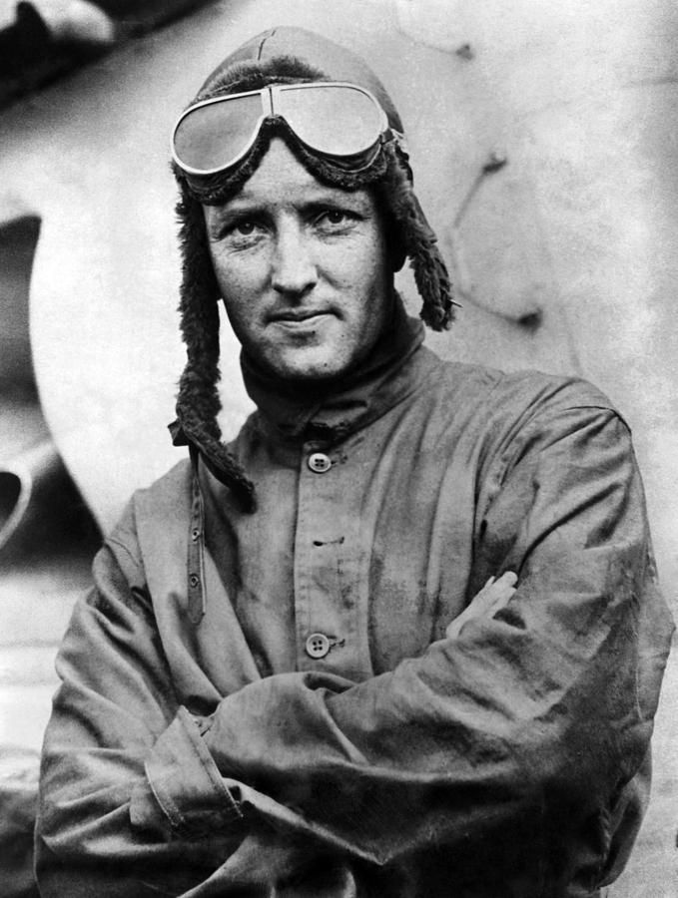
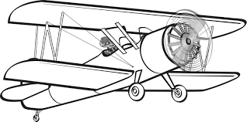
29th November 1929
Ninety years ago today, on the 29th November 1929, Richard Byrd became the first person to fly over the South Pole.
Let’s learn all about this famous explorer!

Slide 5
Richard Byrd
Richard Evelyn Byrd was born on October 25, 1888, in Virginia in the United States of America.
He graduated from the U.S. Naval Academy in 1912. He then entered the U.S. Navy, where he learned to fly aircraft.

Slide 6
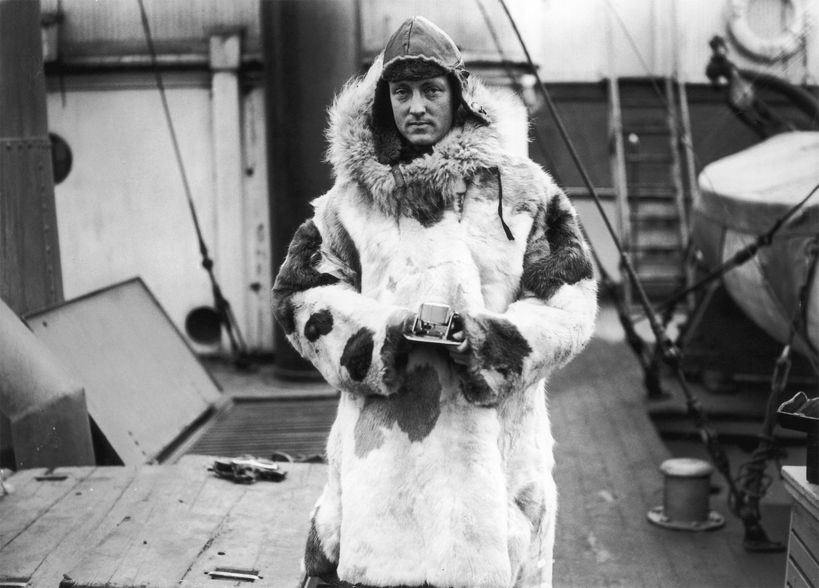
Byrd served in the Navy during World War 1 and began to become interested in navigational equipment. He developed navigational equipment for ‘flying boats’ – one of which made the Navy’s first transatlantic airplane flight in 1919.

Slide 7
His polar career began in 1924 when he was sent on an expedition to western Greenland. This experience of flying over sea ice and glaciers in western Greenland filled Byrd with the ambition to fly over the North Pole.
On May 9, 1926, Byrd, acting as navigator, and Floyd Bennet as pilot, made what they claimed to be the first airplane journey over the North Pole, flying from King’s Bay, Norway, to the North Pole and back. The flight lasted 15¹/₂ hours, with no mishaps beyond an oil leak from the starboard engine of their airplane. For this amazing accomplishment, they were both awarded the U.S. Congressional Medal of Honour and were acclaimed as national heroes.

Slide 8
In 1928, Byrd announced his decision to explore the unknown regions of the Antarctic from the air.
Byrd’s first expedition (1928–30) to Antarctica was the largest ever sent to the continent. Once the explorers arrived in the frozen land, they set up a base named Little America. Byrd then began making flights over Antarctica. The expedition discovered a range of mountains and the unknown territory beyond them. This land is now known officially as Marie Byrd land – as he named it after his wife Marie.

Slide 9
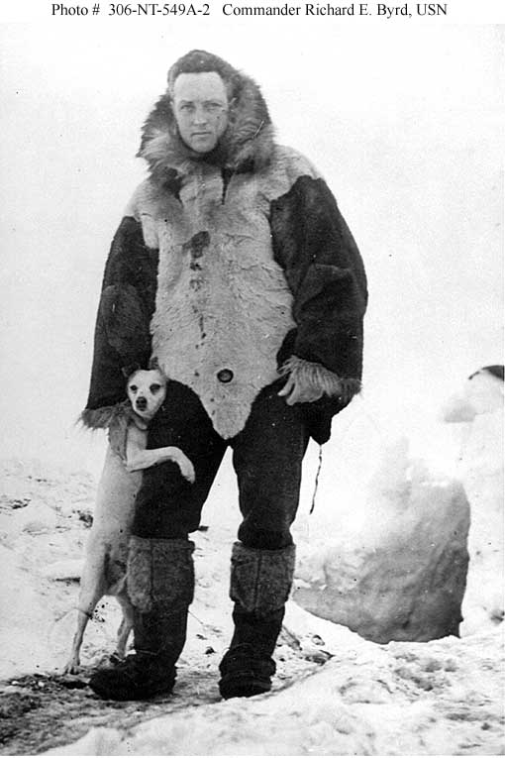
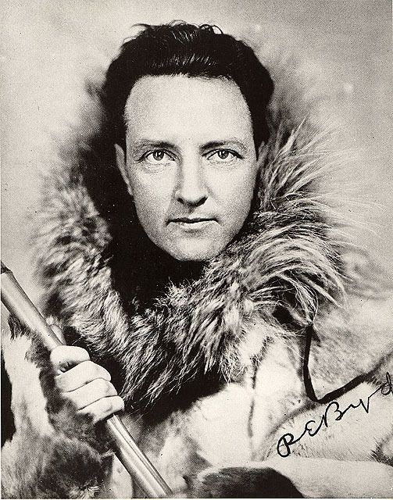

Slide 10
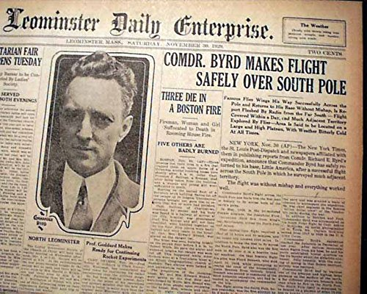
On November 29, 1929, Byrd and three others made the first flight over the South Pole.
They flew from their base – Little America – over the South Pole and back again. It took them 19 hours and there were no mishaps.
This is an amazing achievement. The aeroplanes 90 years ago were much more basic than there are today and the landscape of Antarctica is freezing cold, mountainous and dangerous.

Slide 11
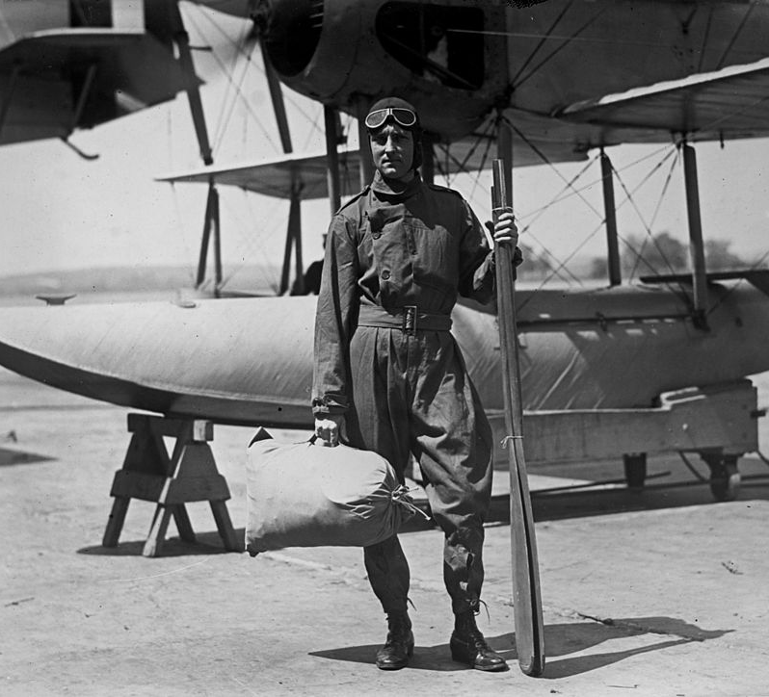
Byrd undertook three more expeditions to the south pole from 1933–35 and 1939–41.
He will be remembered as one of the world’s best aviators as he displayed extraordinary gifts in organizing successful expeditions to previously unexplored regions of Antarctica.

