Slide 1

Partnership with Families: Phonics Screening Check
Notes:
Session to discuss the phonics screening check
Approaching transition to Year 2 – discuss the end of Year 1 expectations for word reading.
End of the session, we will provide a pack of resources that we will go through – specific to your child if needed.

Slide 2
Teach a child to read and keep that child reading and we will change everything.
And I mean everything.
Jeanette Winterson English Author
Notes:
Read quote.

Slide 3
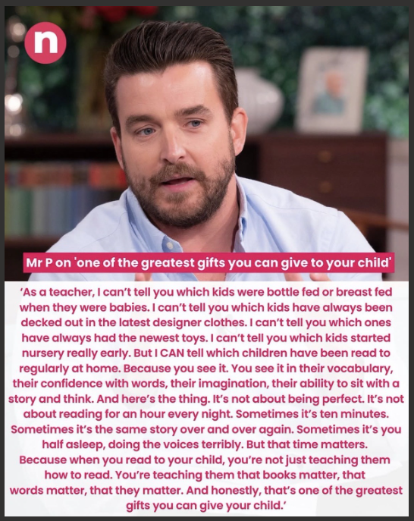

Slide 4
The more graphemes children learn to read and write, the more words they will be able to read and spell, and, as they decode unfamiliar words, they encounter new vocabulary.
The reading framework
Teaching the foundations of literacy
DfE, July 2023
Notes:
A grapheme is simply the written way of showing a sound – for example, they know that S and H makes a sh sound
By the end of Year 1, we want all of our children to be able to read accurately – to read both familiar and unfamiliar words - so that they can go on to become a fluent, enthusiastic reader.
The Phonics Screening Check in June in year 1 is a word reading test to check children can read sounds in words accurately.
Accurate word reading at 6 is a predictor of future success.
This means that children are able to begin building other skills – inference, comprehension etc in Year 2. Having a solid foundation to move forwards on.

Slide 5

What is the Phonics Screening Check?
A word-reading test at the end of Year 1.
Children read 40 words.
Notes:
Children complete the phonics screening check at the end of Year 1 so that parents can be confident their children are being taught to read successfully.
Children read 40 words. It takes between two and five minutes.
If they do not manage to read 32 of the words successfully, they are given extra support, and repeat the check at the end of Year 2. – when extra support is mentioned, this is usually already in place as we are able to identify the children that are on the ‘cusp’ or may not get the pass mark. We want our children to be able to ‘keep up’ rather than needing to ‘catch up’.

Slide 6
Play video:

Slide 7
The complex code
Notes:
Children learn all of the sounds on this chart.
Once they know all of these sounds, they will be able to read any unfamiliar word.
A copy of this is included in the pack that we will speak about later.

Slide 8

‘Special Friends’, ‘Fred Talk’
Notes:
We teach children to words using the routine ‘Special Friends’, ‘Fred Talk’, read the word’.
Children spot the ‘Special Friends’ (two letters that make one sound), Fred talk the word, and then read the whole word.
For example, ‘sh’, sh-i-p, ship.

Slide 9



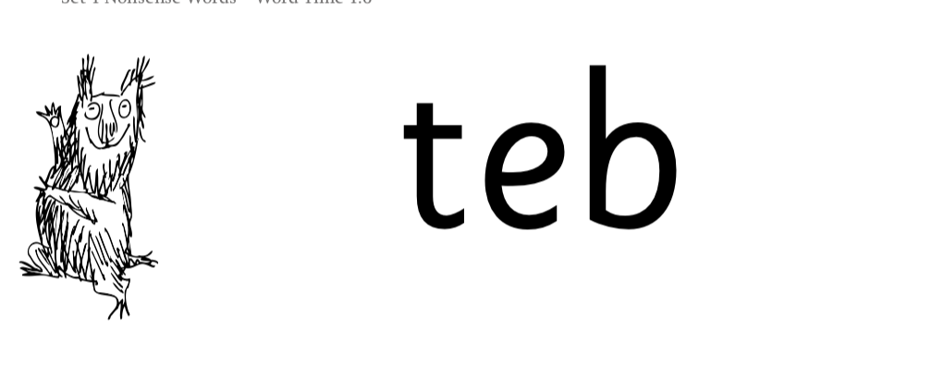
Nonsense words
Notes:
Half of the words in the check are real words.
Half are nonsense words. For example, ‘sheb’, ‘glight’, ‘ched’, ‘teb’.
There is a picture of an alien next to each word to remind the children that it isn’t a real word.
Nonsense words are used to assess children’s reading.
They check that children will be able to read sounds the sounds they know in unfamiliar words.
They read these words using the same routine as real words – ‘Special Friends, Fred Talk.’
Children who can read nonsense words will, very soon, be able to read any new word – for example – gargantuan, flailing, raucous, anticipation;
Reading new words increases children’s vocabulary rapidly.

Slide 10
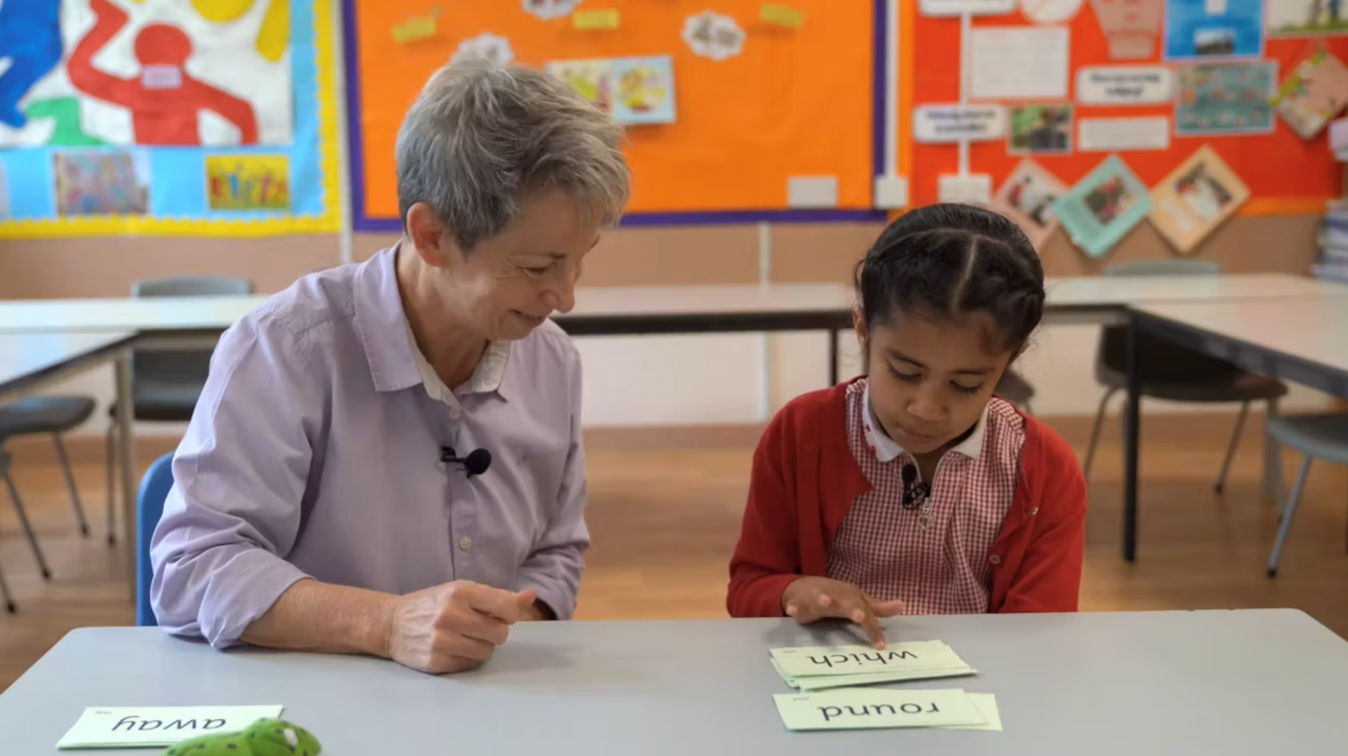
Teach every child to read
Notes:
In our school, we aim to make sure that every child learns to read accurately by the end of Year 1 so they are set up for success in school and in life.
As soon as we spot a child who needs extra practice learning to read sounds and words, we teach them one-to-one for a few minutes every day.
As we mentioned earlier, in the video it spoke about children getting extra support if they do not pass – we have that support in place already in order to keep up.

Slide 11
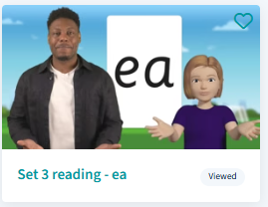
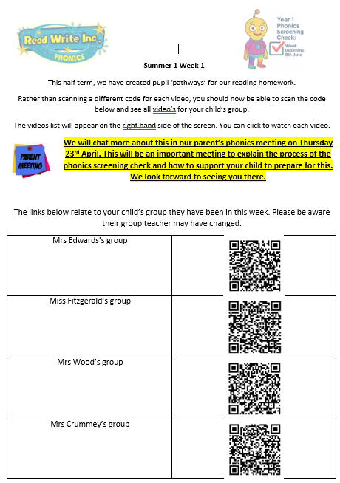
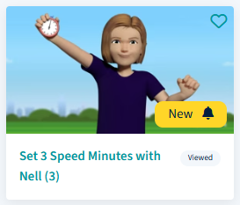
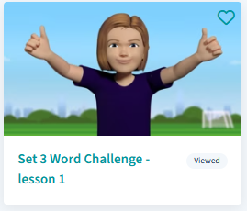
Virtual Classroom films
Notes:
Each week, we will send home film links to lessons that match the sounds and words your child has been learning in school. Please do use these.
We will also include 5-minute Word Challenge films and 1 minute speed minute films.
We use these in school – familiar to the children.
Some videos will practise reading the sounds and others will be sounds and words
Keep doing until they can read them speedily.
The more they practise using these films, the quicker they’ll learn to read.
Simply scan the QR code and watch on a tablet or other device.

Slide 12

How do I use the Virtual Classroom?
Set aside 10 minutes to watch a film with your child each day.
Find a quiet space for your child to watch the film on a laptop or tablet.
Praise your child as they join in with the lesson – make it fun!
The more they practise using these films, the quicker they’ll learn to read.
Notes:
Set aside 10 minutes to watch a film with your child each day.
Find a quiet space for your child to watch the film on a laptop or tablet.
Praise your child as they join in with the lesson – make it fun!
The more they practise using these films, the quicker they’ll learn to read.
1 QR code should bring up a range of videos rather than just 1

Slide 13
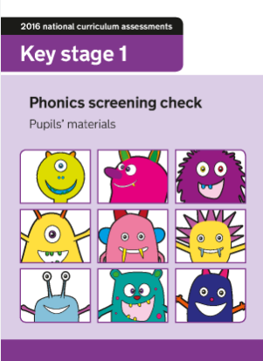
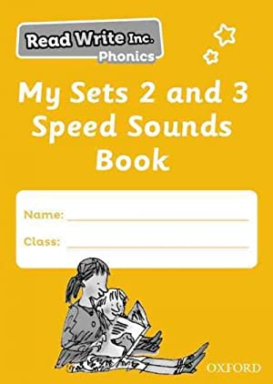
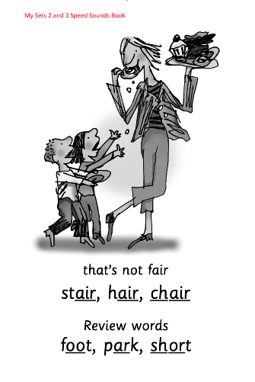
Practice at home
Notes:
Your child will also bring home a My Set 2 and 3 Speed Sounds books to practise reading and writing the Set 2 and 3 sounds and words.
There are instructions for you inside cover of the book.
Purchased by school
Each week as their English homework, we will send home a past phonics screening check for you to practice reading with your child. This will help the check to be familiar for the children. Encourage them to spot the special friends before fred talking the words.
Use QR codes as mentioned.

Slide 14

What can I do?
Help your child to use ‘Special Friends’, ‘Fred Talk’ to read words.
Practise reading sounds speedily.
Watch the Virtual Classroom films together.
Listen to your child read their Storybook every day.
Notes:
Help your child to use ‘Special Friends’, ‘Fred Talk’ to read words.
Practise reading sounds speedily.
Watch the Virtual Classroom films together.
Listen to your child read their Storybook every day.

Slide 15
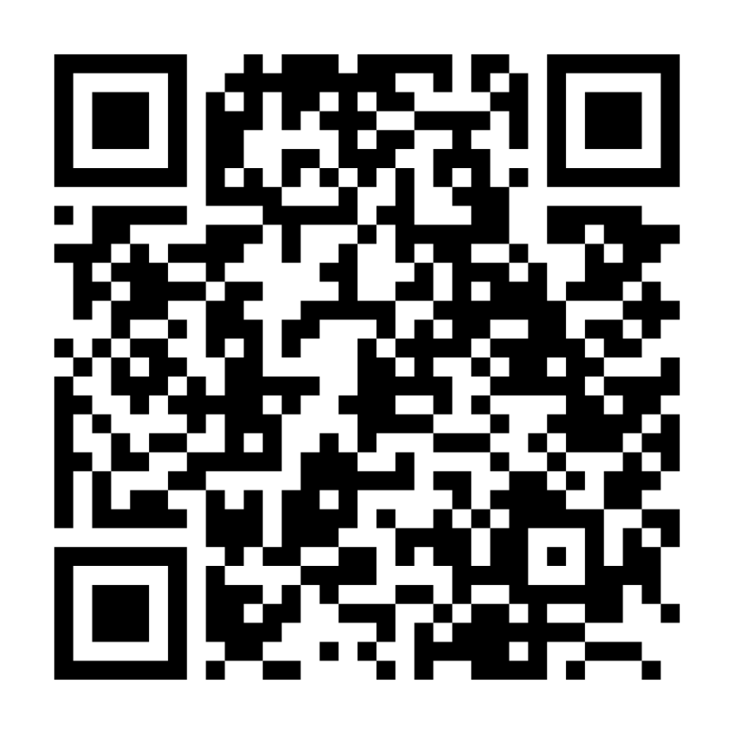


Online resources available
Ruth Miskin Families Page:
https://www.ruthmiskin.com/parentsandcarers/
Ruth Miskin Facebook:
https://www.facebook.com/miskin.education
Free e-books for home reading:
http://www.oxfordowl.co.uk/Reading/
Notes:
These have been put onto a sheet – QR codes at the top for parents with other resources underneath
Show the pack of resources

Slide 16
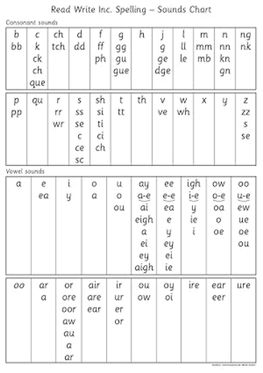
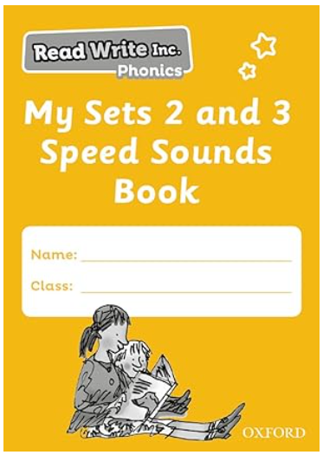
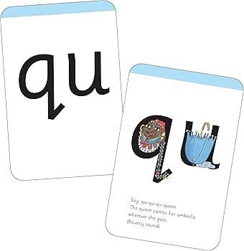
Thank you for all of your support. Please collect your child’s resource pack from the table.

