Slide 1

Relationship and Sex Education in Emmaus Primary School

Slide 2


Slide 3
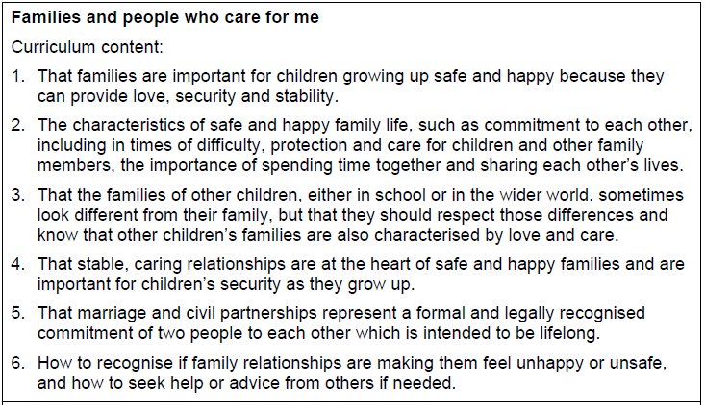

Slide 4
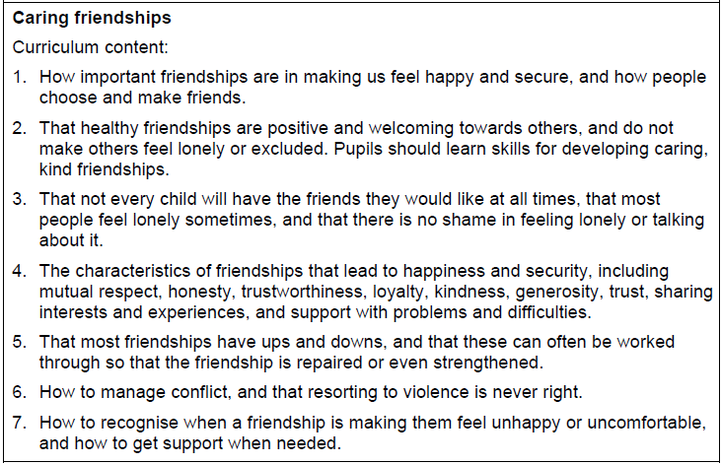

Slide 5
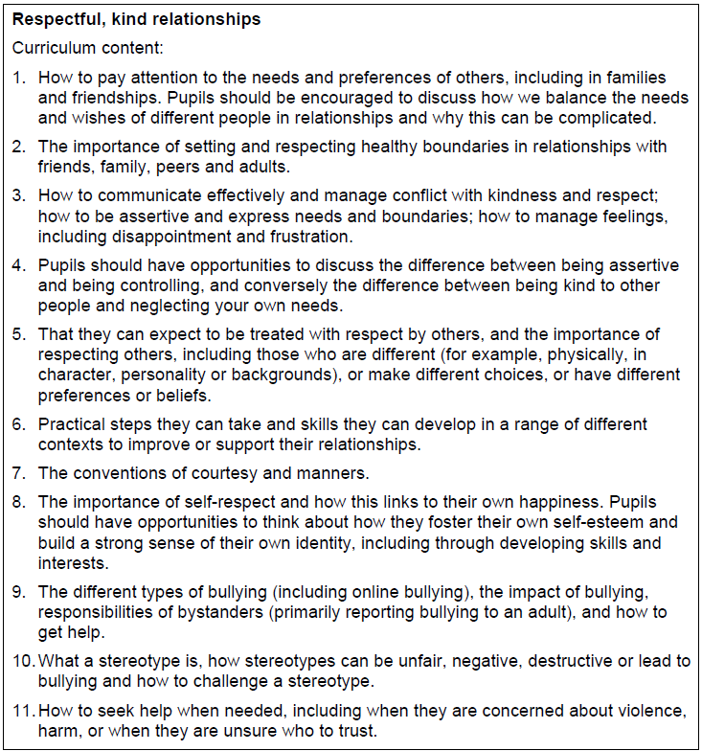

Slide 6
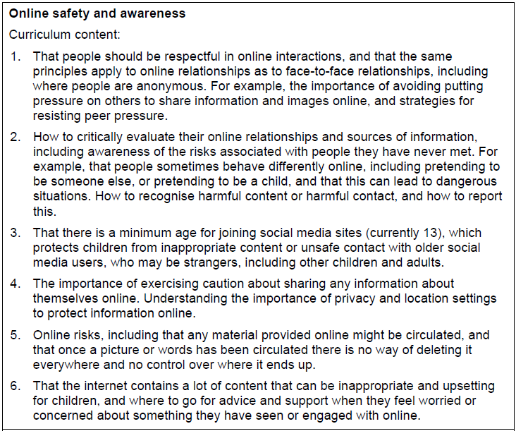

Slide 7
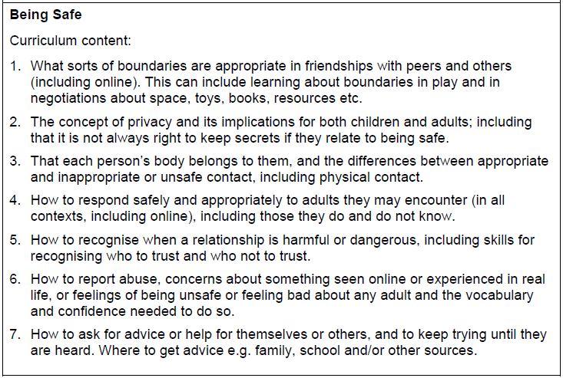

Slide 8
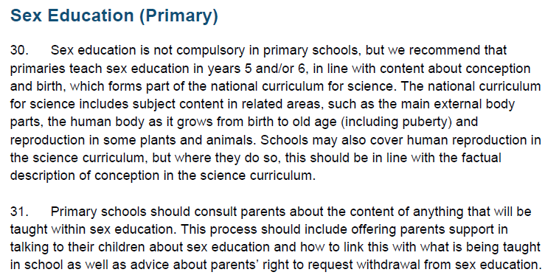

Slide 9

This is a programme designed to help children develop the knowledge, skills and attributes they need to thrive as individuals, family members, and members of society. It emphasises emotional literacy, resilience, mindfulness, social skills, and spiritual developments, nurturing well-rounded, compassionate learners while supporting academic growth. The programme aligns with statutory requirements for Relationships and Health Education.
WE DO NOT TEACH THE SEX EDUCATION ELEMENT FROM JIGSAW!

Slide 10

As a church school, teachers adapt the content to ensure that this fulfils church views.

Slide 11

Online Safety and awareness
Online safety performances in school
Online safety week
Ongoing messages throughout the year
Purple Mash –
Safety features on our school network – children’s search engine swiggle, firewall in school

Slide 12

At the heart of this programme is our belief that we are all made in the image and likeness of God, and consequently, gender and sexuality are God’s gift, reflecting his beauty and sharing in divine creativity.
In order that children may grow and flourish healthily and holistically towards an understanding of their gender and its implications for successful relationships they must be at ease with themselves and deepen their self-knowledge.

Slide 13
Focus for each year group
Early Years - The wonder of being special and unique
Year One - We meet God’s love in our family
Year Two - We meet God’s love in the community
Year Three - How we live in hope
Year Four - God loves us in our differences
Year Five - God loves us in our changing and developing
Year Six - The wonder of God’s love in creating new life

Slide 14
Three age-related units in each year group that give children an experience of connecting every aspect of growth: Social, emotional, physical and spiritual.
Autumn term - Social and Emotional
Spring term - Physical
Summer term - Spiritual

Slide 15
Year Group | Theme | Key Objectives
EYFS (Nursery & Reception) | The wonder of being special and unique | Develop self-esteem, recognise feelings, understand family love and care, appreciate uniqueness and friendships.
Year 1 | We meet God’s love in our family | Understand family relationships, belonging, love, trust, care, and respect within families.
Year 2 | We meet God’s love in the community | Build friendships, value cooperation, understand responsibilities, and appreciate school and parish communities.
Year 3 | How we live in love | Develop virtues such as honesty, loyalty, forgiveness, kindness, and positive conflict resolution.
Year 4 | God loves us in our differences | Respect diversity and individuality, understand personal growth, and build empathy and acceptance.
Year 5 | God loves me in my changing development | Learn about puberty, emotional and physical changes, hygiene, self-care, and positive self-image.
Year 6 | The wonder of God’s love in creating new life | Understand human reproduction, relationships, responsibility, dignity, and preparation for secondary school.

Slide 16
Year 5 – God Loves Me in My Changing Development
Learning Objectives:
• Recognise signs of puberty
• Understand that change is natural
• Develop confidence and self-respect
• Learn to care for changing bodies
Physical changes in puberty:
Growth spurts, body hair, skin changes, menstruation, voice changes, sweating, hormonal changes.
Emotional changes:
Mood swings, changing friendships, increased independence, worries and anxieties.
Personal hygiene:
Washing, deodorant, dental care, menstrual hygiene, healthy habits.
Self-image and dignity:
Respecting their bodies and understanding they are uniquely valued.
Feelings and relationships:
Managing emotions appropriately, empathy, and respect for others.
Safety and communication:
Asking trusted adults for help, understanding privacy and boundaries.

Slide 17
Year 6 – The Wonder of God’s Love in Creating New Life
Learning Objectives:
• Understand how new life begins
• Recognise responsibilities in caring relationships
• Prepare emotionally and socially for adolescence
• Develop confidence for transition to secondary school
Human reproduction:
Sexual intercourse, fertilisation, conception, pregnancy, and birth.
Development of a baby:
Growth in the womb and stages of pregnancy.
Love and commitment:
Marriage, loving relationships, family life, and responsibility.
Respect and dignity:
Respecting self and others, personal boundaries, age-appropriate consent.
Emotional maturity:
Managing emotions, peer pressure, friendships, and preparing for secondary school.
God’s gift of life:
Understanding life as sacred and valued.

Slide 18
Journey in Love – Vocabulary by Year Group
Year Group | Typical Vocabulary Focus
EYFS | family, love, care, feelings, friend, special, unique, kind, happy, sad, sharing, helping
Year 1 | family, belonging, trust, respect, relationship, caring, listening, love, safe, responsibility
Year 2 | community, friendship, cooperation, sharing, fairness, neighbour, kindness, inclusion, support
Year 3 | honesty, loyalty, forgiveness, conflict, responsibility, empathy, behaviour, trust, emotions
Year 4 | differences, diversity, individuality, acceptance, respect, body changes, growth, self-esteem, identity
Year 5 | puberty, menstruation, hormones, hygiene, emotional changes, self-image, privacy, boundaries, confidence, adolescence
Year 6 | reproduction, fertilisation, conception, pregnancy, womb, birth, relationships, dignity, commitment, responsibility, consent, transition

Slide 19

No Outsiders is a primary school equality and inclusion programme created by Andrew Moffat. It is based on the Equality Act 2010 and uses storybooks to teach children about inclusion, diversity, respect, and belonging.

Slide 20
Year Group | Main Theme / Focus | Key Objectives
EYFS (Reception) | Belonging and kindness | Understand that everyone is welcome, celebrate similarities and differences, develop friendships, show kindness and respect.
Year 1 | Recognising difference | Understand that people are different in many ways, value individuality, learn about fairness and friendship, develop empathy.
Year 2 | Diversity in families and communities | Recognise different family structures, understand fairness and inclusion, challenge unkind behaviour, appreciate diversity.
Year 3 | Rights, respect and equality | Learn that everyone has equal rights, develop respectful language and behaviour, understand stereotypes and fairness.
Year 4 | Identity and acceptance | Explore personal identity, understand diversity in society, respect differences including faith, culture and family background.
Year 5 | Challenging discrimination | Discuss prejudice and discrimination, develop critical thinking, understand protected characteristics in an age-appropriate way, promote inclusion.
Year 6 | Equality, citizenship and social responsibility | Prepare for life in a diverse society, discuss equality and justice, develop confidence to challenge discrimination and exclusion respectfully.

Slide 21
Children are encouraged to:
recognise that “there are no outsiders”
respect all protected characteristics under the Equality Act 2010
celebrate diversity
challenge stereotypes
develop empathy and kindness
build inclusive communities
understand democracy, fairness, and human rights.
Common protected characteristics explored age-appropriately
The programme may include discussion of:
age
disability
race
religion or belief
sex
gender reassignment
sexual orientation
family structure
marriage and civil partnership.

Slide 22
