Slide 1

Welcome
School Mission Statement
We are friends journeying together in faith, hope and trust as we live, love and learn together.

Slide 2

Attendance Matters At Emmaus
Please ensure your child arrives for school on time
Telephone school if your child is to be late
For routine non-emergency medical and dental appointments please ensure they are
made outside of school hours
Contact school preferably by 10.00 am on the first day of absence if your child is unable to attend through illness, giving an indication of the expected duration and return date to school.
If a text message/phone call is received as a result of your child’s absence it is important that you respond to this text to ensure your child is appropriately safeguarded.
Contact Mrs Hope (Attendance Lead) or Mr Williams (Headteacher) if the reason for absence requires a more personal contact.
Holidays in term time will not be authorized and will result in a fine

Slide 3

Reading is everything at Emmaus
Our aim is to ensure that every child becomes a fluent reader.
The Top Ten Benefits of Reading for Children
Their vocabulary is larger and more extensive.
They perform better academically.
Their imagination can run wild.
Their creativity skills develop.
They develop empathy.
They gain a deeper understanding of their world.
Their concentration levels improve.
The parent and child bond improves.
Their cognitive development is supported.
Their social skills and interaction improve.

Slide 4
Reading is everything at Emmaus
How Parents Can Read with Their Child
If you read with your child at home, then you are supplementing what they learn in the classroom as well as giving them additional one-on-one support that the classroom cannot always give.
To have successful and effective reading sessions, consider the following:
Make it part of your routine.
Encourage variation of books.
Have patience with your child.
Continue the discussion after you have read the story.

Slide 5

Homework
Reading, spellings and times tables
Homework is sent home each Friday and is returned
on Wednesdays. This will contain a Literacy & Maths task, spellings and a reading book. All children should have a reading book in their tray either from home or school.
Homework should be completed in books and not on sheets.
A research project may be set for homework. This can be set out in preferred style such as, PPTs, fact files etc.
Spellings and times tables will be tested each Monday.

Slide 6

Trips
There will be a number of trips & visitors planned
throughout the year.
Details will always be sent in advance via the Parent App.

Slide 7

PE
PE curriculum is as follows:
5B– Wednesday afternoon
5C – Thursday afternoon
Please make sure all PE clothing is clearly labelled.
Please make sure kits are kept in school for additional PE sessions.
Swimming lessons will take place in the spring term.

Slide 8

Snacks
We strive to be a healthy school and maintain our healthy school award.
Water bottles and fruit snacks are welcome each day.

Slide 9
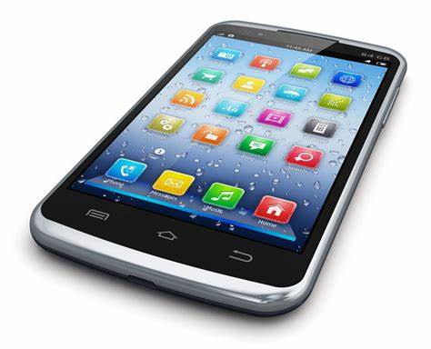
Walking home and mobile phones
If you allow your child to walk home or walk to another classroom, please put it in writing, sign it and pass to the office. School systems are updated regularly with this information.
If your child has permission to walk home and a mobile phone is brought to school, a form must be filled in on the parent app.
This has rules that you must share with your child before the phone is brought to school.

Slide 10

School Website
Please check the school website for curriculum plans
Spellings and class/year group photographs
School term dates etc

Slide 11

Questions

