Slide 1


Year 4 - Meet the teacher
https://www.emmausschool.co.uk/mission-statement-values-and-ethos/

Slide 2
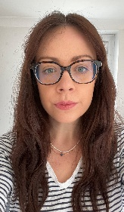
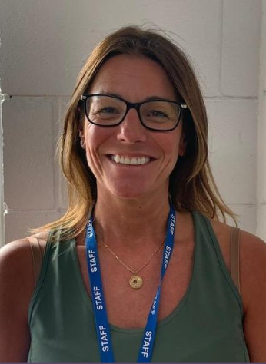
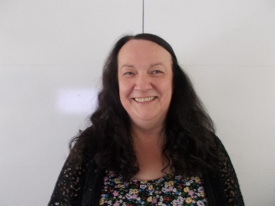
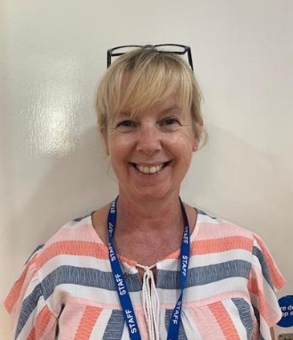
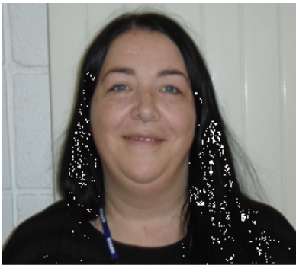

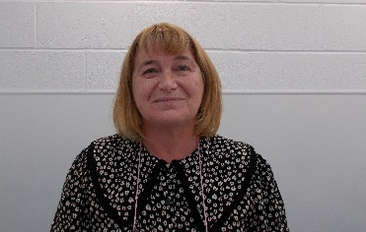
Year 4 Staff
Miss Dickson Miss Williams Mrs Murphy
Mrs Richmond Mrs Lockhart Mrs Jabakhanji Miss Melia

Slide 3
Attendance Matters At Emmaus
Please ensure your child arrives for school on time – 8:50-8:55.
Telephone school if your child is going to be late.
For routine, non-emergency medical, and dental appointments, please ensure they are made outside of school hours.
Contact school preferably by 10.00 am on the first day of absence (if your child is unable to attend through illness, giving an indication of the expected duration and return date to school).
If a text message/phone call is received as a result of your child’s absence, it is important that you respond to this text to ensure your child is appropriately safeguarded.
Contact Mrs. Hope (Attendance Lead), or Mr. Williams (Headteacher) if the reason for absence requires a more personal contact.
Holidays in term time will not be authorised and will result in a fine.

Slide 4
Behaviour Expectations
We aim to create a calm, secure and happy school based on the values of the Gospel and in particular our chosen Christian values of Hope, Friendship, Love and Trust.
We believe that good behaviour is essential to a successful learning environment.
“Treat others how you would like to be treated.”
School Rewards
Praise
Stickers
Certificates
Assembly celebrations (Merits)
House points
Annual awards
Sports’ Day awards
Annual Attendance awards
Whole School Rules
We are kind and helpful
We listen when others are talking
We take care of our school, our world and each other
We always try our best to ‘Reach for the Stars’

Slide 5


Praising your child
In 4D, every time a child wins a house point, they receive a raffle ticket
Children place these in a box
At the end of the week, 2 names are pulled out to receive a prize
There are a range of different items to choose from like bookmarks, pens, felt tips, coloured pencils, rubbers, sharpeners and pin badges

Slide 6
Warnings and Consequences
Verbal warning
Name on the board
Cross put beside child’s name and 5 minutes play time lost
Another cross by child’s name, all play time lost (15 minutes at lunch time), and sent to the parallel Teacher, parents contacted by the teacher who logs the behaviour
Child referred to Senior Leadership Team member, and parents contacted by SLT, who logs the behaviour, and a Behaviour Plan will be agreed by all parties

Slide 7
Website
All information should be available through our Year 4 website page:
Check it for:
the weekly diary,
spellings,
games,
photographs
other important information

Slide 8
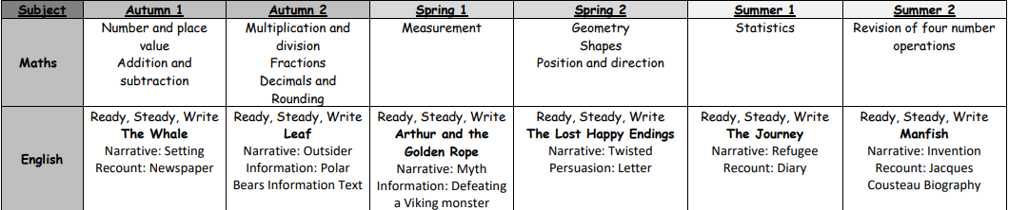
This Year’s Topics
We will continue with the scheme Ready Steady Write. This will improve children’s skills in grammar, spelling, composition and punctuation.

Slide 9

This Year’s Topics
Some other exciting topics include:
Sewing and making cushions, cooking a stir fry, coding, animation, watercolour landscapes, abstract art, French conversation, gymnastics, tennis and singing.

Slide 10
Year 4’s Multiplication Tables Check (MTC)
It is an assessment for Year 4 pupils in England to evaluate their multiplication skills up to 12 x 12
The check consists of 25 questions with a time limit of 6 seconds per question
It is designed to ensure that children have a solid grasp of multiplication facts, which is essential for tackling more advanced mathematical topics
The MTC is a statutory assessment introduced by the UK government to improve mathematical fluency and confidence
There is no pass rate for the check and children will not be expected to repeat the check
Schools have a two week window to complete the check – this will be in June 2026
Children will not be able to see their score at the end of the check
Results will be available when the end of year reports are sent home

Slide 11
Year 4’s Multiplication Tables Check (MTC)
How are we preparing your child at school?
Regular sessions on Times Tables Rock Stars
Regular games and quizzes
Regular assessment to identify any tables that need further practice
Intervention groups
Times Tables taught in Basic Skills sessions (during the maths lessons)
How can I help my child at home?
Times Tables Rock Stars
Hit the Button (Hit the Button - Quick fire maths practise for 6-11 year olds)
Maths Factor (The Maths Factor Times Tables Check – Menu)
Multiplication Tables Check (Multiplication Tables Check - 2025 - Timestables.co.uk)

Slide 12

Other Key Information:
PE:
Friday for 4D
Friday for 4MW
Swimming is after Christmas
Homework:
handed out on Friday
returned by the following Wednesday
The children will be given Maths and English homework.
Children to copy the work into their homework books (do not write onto the sheets).
Trips:
Romans in Autumn Term (Chester)
PGL in Summer Term 2026
Geography Fieldwork

Slide 13

Reading is everything at Emmaus
Our aim is to ensure that every child becomes a fluent reader
The Top Ten Benefits of Reading for Children:
Their vocabulary is larger and more extensive.
They perform better academically.
Their imagination can run wild.
Their creativity skills develop.
They develop empathy.
They gain a deeper understanding of their world.
Their concentration levels improve.
The parent and child bond improves.
Their cognitive development is supported.
Their social skills and interaction improve.

Slide 14
Reading is everything at Emmaus
Our aim is to ensure that every child becomes a fluent reader.
Each week, Children will have:
Four shared reading sessions (whole class). We are following a new scheme this year.
These sessions focus on comprehension skills, how to answer a range of questions to increase fluency and stamina.
Shared reading:
Exposes ALL children to sophisticated, age related text extracts.
Teacher models how to read and demonstrates how to locate answers through various teaching methods.
There will be reading sessions (interventions) with smaller groups of children who struggle with comprehension and fluency.

Slide 15
Reading is everything at Emmaus
How can Parents/Carers Read with Their Child?
If you read with your child at home, then you are supplementing what they learn in the classroom as well as giving them additional one-on-one support that the classroom cannot always give.
To have successful and effective reading sessions, consider the following:
Make it part of your routine.
Encourage variation of books.
Have patience with your child.
Continue the discussion after you have read the story.

Slide 16

Children are taught 10 new words at the beginning of each week.
Children are taught how to spell the words through various games (clapping syllables/ counting phonemes (sounds)).
Children learn what the words mean in a context sentences.
Throughout the week, the children re visit the words through various incidental activities.
  Rainbow words/ Graffiti writing/ Waterfall words
Children are given the word lists at the start of the half term. The word lists will also be available on the Year 4 website.
Tested on Monday.
10 House Points for 10/10
5 House Points for ‘effort’
Some children will be assessed individually in the autumn term. They may join a spelling intervention group where they will learn more accessible spellings. They will be given these words for homework and then assessed on them.

Slide 17
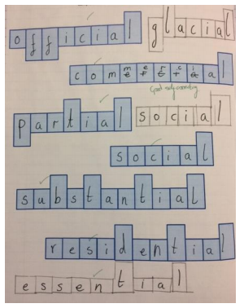
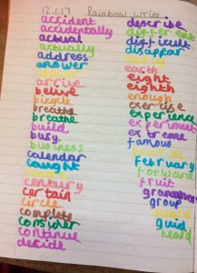
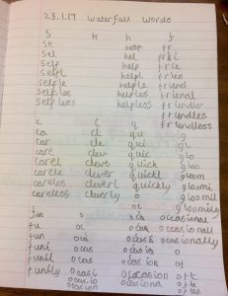
Spellings
FamilyID=Office_ArchiveTorn

Slide 18


Collective Worship and PSHE
CW Themes:
Generosity
Compassion
Courage
Forgiveness
Friendship
Respect
PSHE
We have PHSE lessons every week
The lessons are about friendship, working together, internet safety and self-image etc.
We have one lesson naming body parts in the Summer Term.

Slide 19
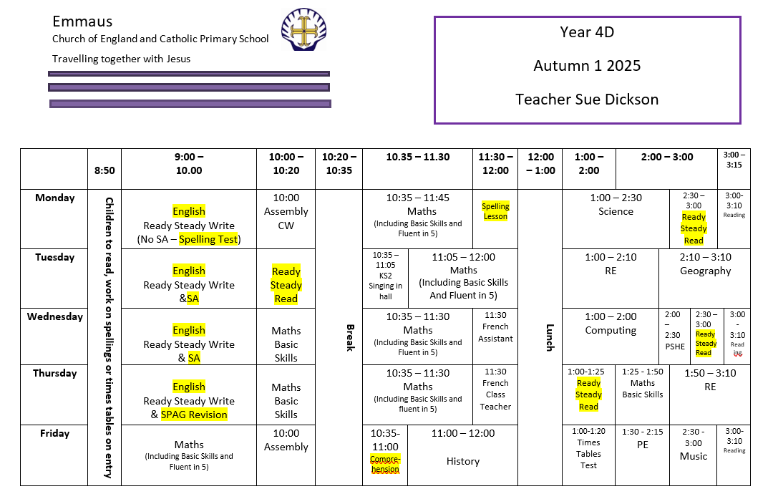

Slide 20

PE
PE Kit:
Black shorts
White T-shirt
Pumps for indoors and trainers for outdoors
In year 4, the children may also need an Emmaus navy blue sweatshirt and jogging bottoms.
PE kit can be purchased from Brienda.
A text message will be sent home if a child does not have their kit and a record is made to monitor this.

Slide 21
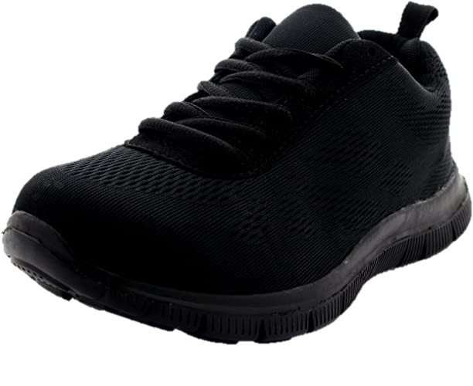

Uniform
White shirt
School tie
Grey skirt/pinafore or grey shorts/trousers
Grey socks with shorts/ trousers
Grey socks or grey tights with skirt/pinafore
School jumper /cardigan
Black plain school shoes
(not trainers or ‘trainer style’ shoes; no logos or colours)

Slide 22
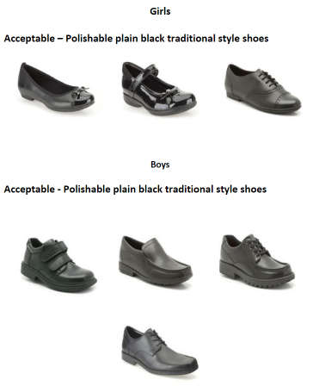


Shoes

Slide 23

Snacks and Lunch
Children can only bring fruit or vegetables for their snacks.
Children should not bring to school chocolate, sweets, crisps or fizzy drinks for their packed lunches.
Children can bring a water bottle (with their name on) into school and refill this during the school day.
We are a NUT FREE school, please check items in packed lunches.

Slide 24

PGL
Wednesday 29th April to Friday 1st May 2026

Slide 25
PGL
The cost of the trip is £240
Deposits need to be paid by 30th September, so numbers can be given to PGL staff
The residential is for 2 nights and 3 days
We leave on Wednesday morning and arrive for lunch (provided by PGL)
We return on Friday for home time – 3:15pm
We have 5 activities per full day, 2 in the morning, 2 in the afternoon and 1 in the evening
There are lots of activities – high up and at ground level

Slide 26
PGL
There will be a meeting in April to give further information
For sleeping, children will need a sleeping bag and a pillow
Children sleep in bunkbeds and there are between 4 and 12 children in a room
Groups for rooms and activities are mixed from both classes usually

Slide 27
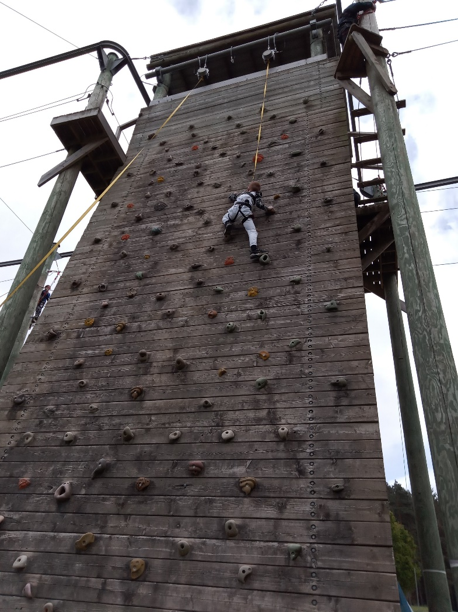
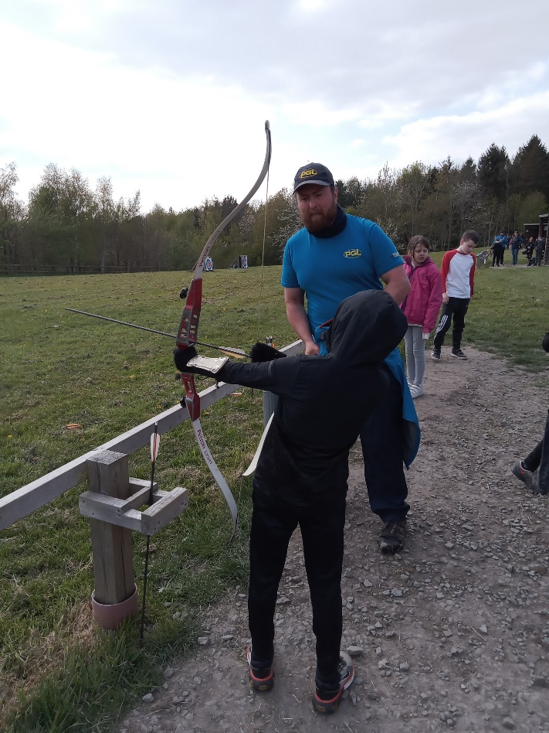
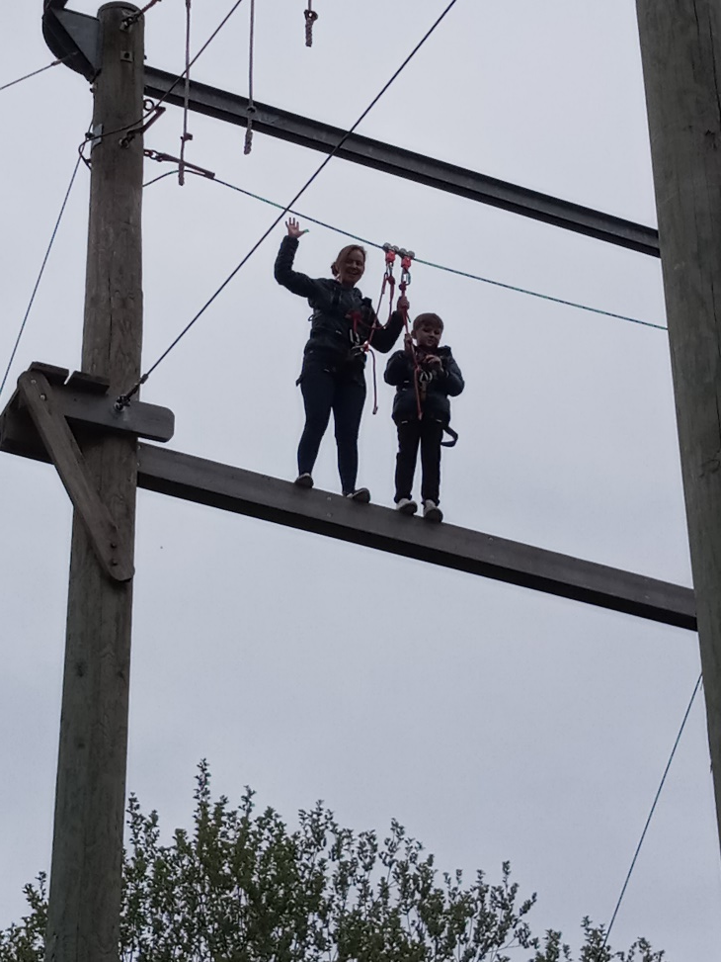
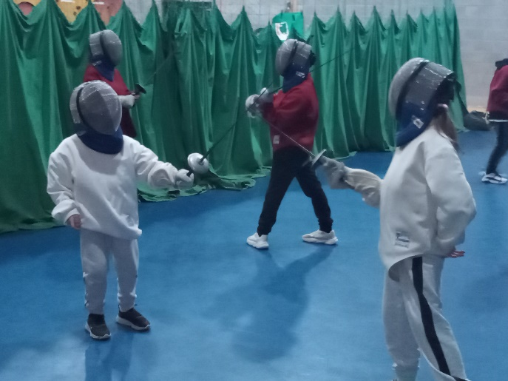
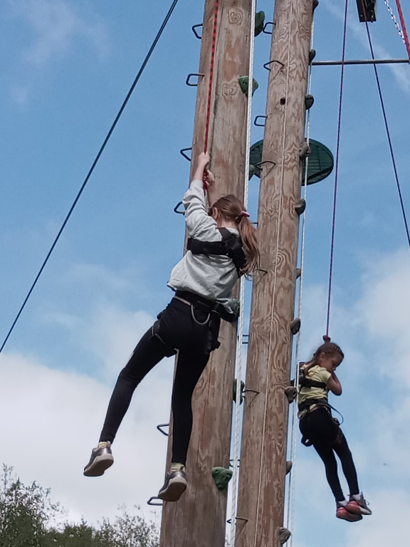
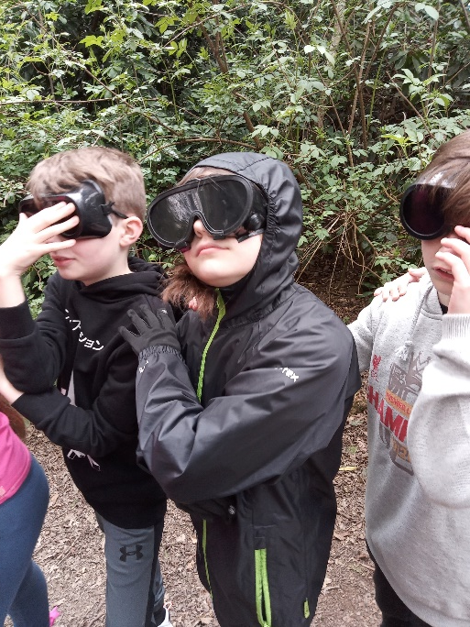
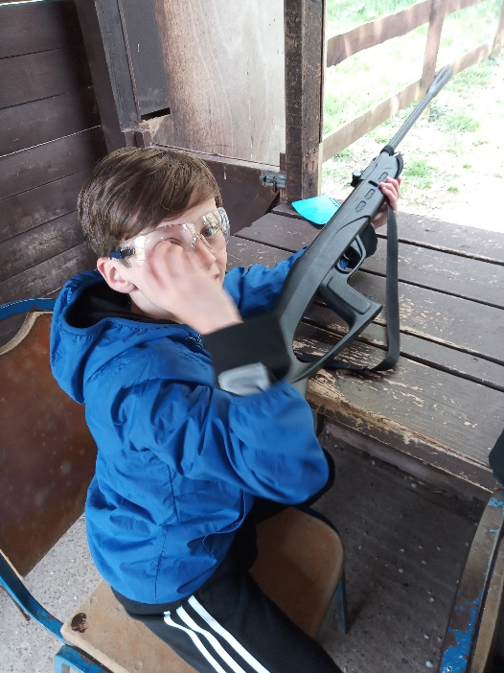

Slide 28

Thank you for listening!

