Slide 1


Year 4 - Meet the teacher
https://www.emmausschool.co.uk/mission-statement-values-and-ethos/

Slide 2
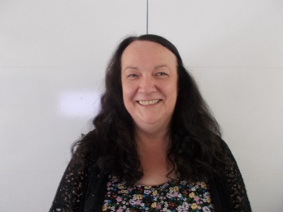
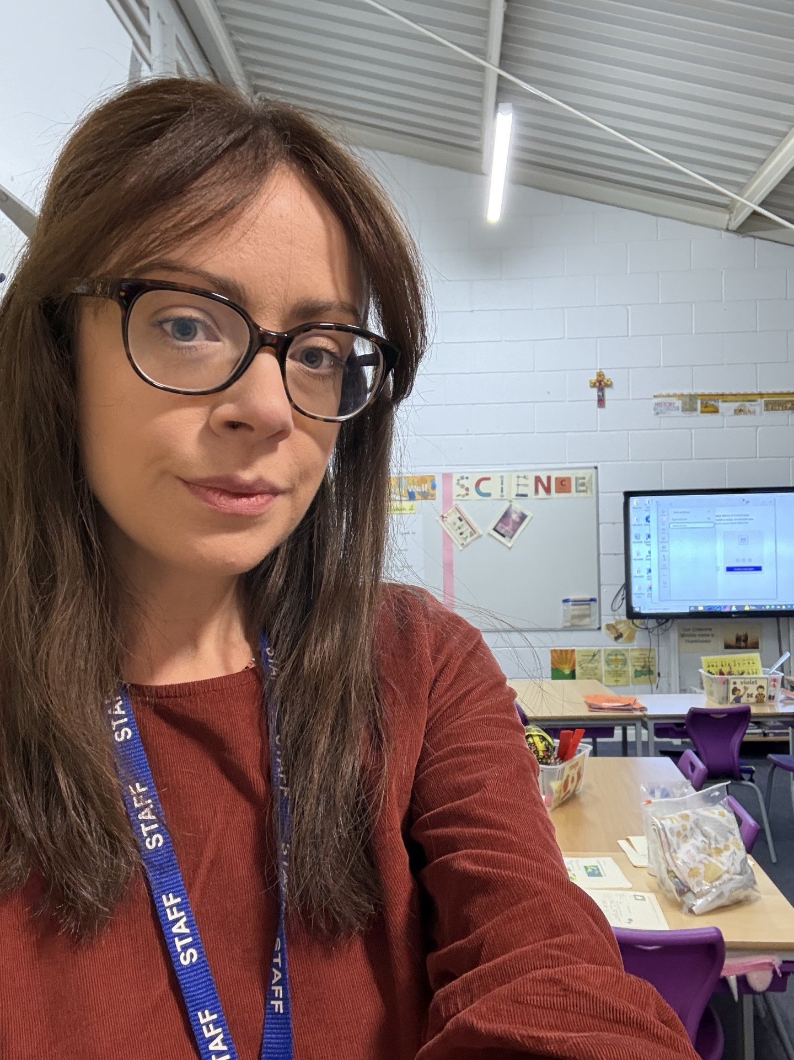
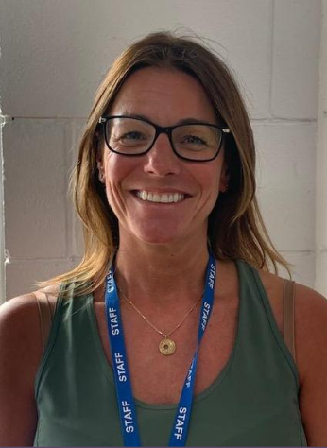
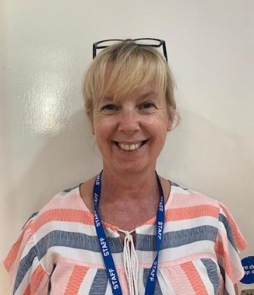
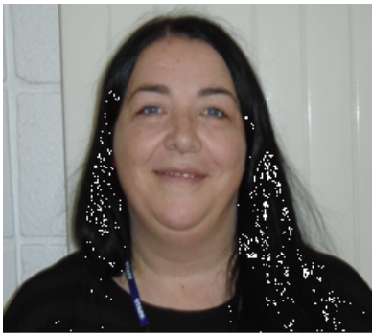

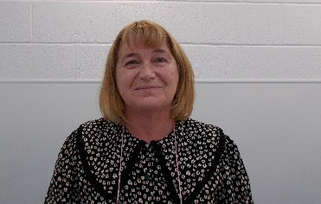
Year 4 Staff
Miss Dickson Miss Williams Mrs Murphy
Mrs Richmond Mrs Lockhart Miss Jabakhanji Miss Melia

Slide 3
Attendance Matters At Emmaus
School Attendance Guidelines
Arrival Time:
Children should arrive at school between 8:50 and 8:55 AM.
Late Arrival:
If your child will be late, please call the school office to inform them.
Appointments:
Routine medical and dental appointments should be scheduled outside school hours.
Absence Due to Illness:
Contact the school by 10:00 AM on the first day of absence, stating:
  Reason for absence
  Expected duration
  Anticipated return date
Safeguarding:
If you receive a text or call about your child’s absence, respond promptly to ensure safeguarding.
Personal Contact:
For sensitive absence reasons, contact:
  Mrs. Hope (Attendance Lead)
  Mr. Williams (Headteacher)
Term-Time Holidays:
These will not be authorised and may result in a fine.

Slide 4
🌟 Whole School Rules at Emmaus
We aim to create a calm, secure and happy school based on the values of the Gospel and in particular our chosen Christian values of Hope, Friendship, Love and Trust. We believe that good behaviour is essential to a successful learning environment.
“Treat others how you would like to be treated.”
At Emmaus, we believe in creating a kind, respectful and encouraging environment for everyone. Our school rules help us to do just that:
We are kind and helpful
We listen when others are talking
We take care of our school, our world and each other
We always try our best to ‘Reach for the Stars’
These simple rules help us all to feel safe, valued and ready to learn.

Slide 5
🌟 School Rewards at Emmaus
We love to celebrate the achievements, effort, and positive behaviour of our children.
Here are some of the ways we reward and recognise them throughout the year:
Praise from staff
Stickers for great work or behaviour
Certificates for special achievements
Merits celebrated in assembly
House points contributing to team success
Annual awards for outstanding contributions
Sports Day awards for effort and performance
Attendance awards for excellent attendance
These rewards help to motivate and encourage children to always try their best and be proud of their efforts.

Slide 6
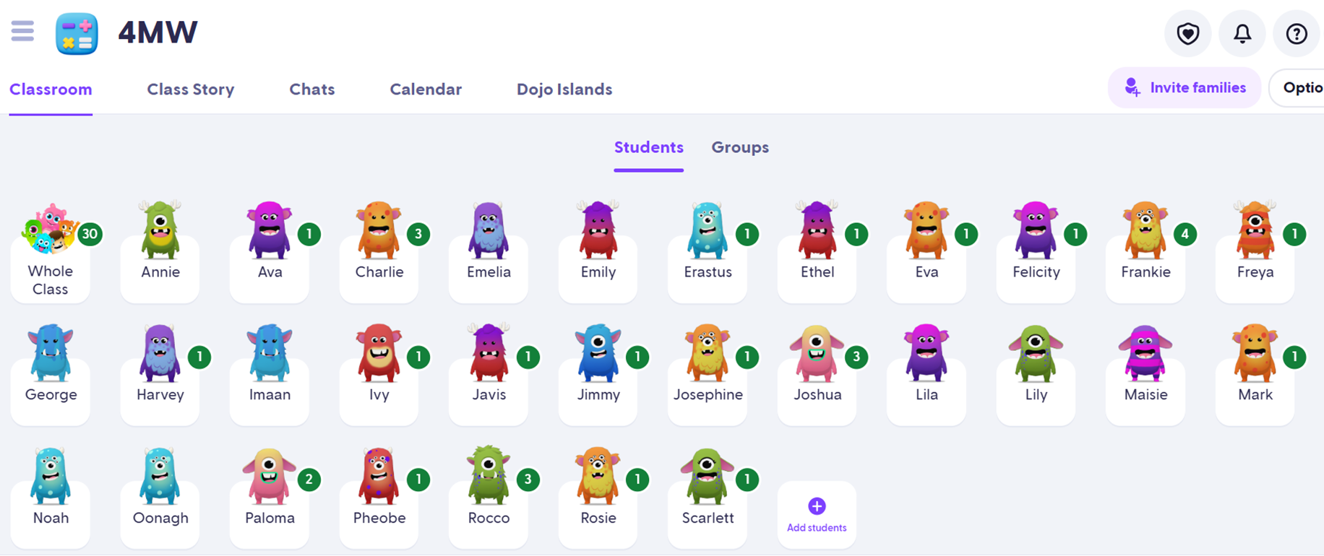
4MW Rewards

Slide 7
Warnings and Consequences
Behaviour Management Steps
Verbal Warning
  Child is given a verbal reminder about their behaviour.
Name on the Board
  Child’s name is written on the board as a visual cue.
First Cross
  A cross is placed next to the child’s name.
  Consequence: 5 minutes of playtime is lost.
Second Cross
  Another cross is added.
  Consequence: All playtime is lost (15 minutes at lunchtime).
  Child is sent to the parallel teacher.
  Parents are contacted by the teacher.
  Behaviour is logged by the teacher.
Referral to Senior Leadership Team (SLT)
  Child is referred to an SLT member.
  Parents are contacted by SLT.
  Behaviour is logged by SLT.
  A Behaviour Plan is agreed upon by all parties.

Slide 8
Website
Stay Updated on Our Year 4 Website!
Visit our Year 4 page regularly to find:
🗓️ Weekly Diary – Keep track of what’s happening each week
✏️ Spellings – Practice the latest spelling lists
🎮 Games – Fun and educational activities to enjoy
📸 Photographs – See what we’ve been up to in class
📌 Important Information – Don’t miss key updates and notices

Slide 9
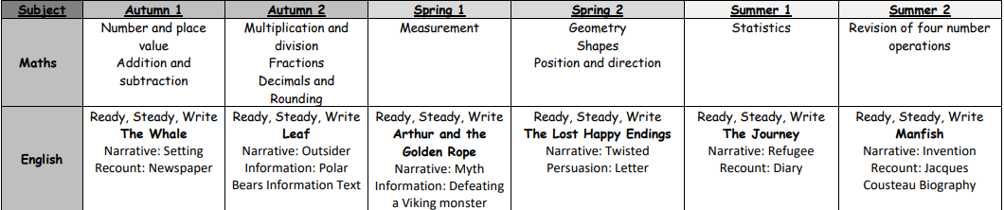
This Year’s Topics:
We will continue with the scheme Ready Steady Write. This will improve children’s skills in grammar, spelling, composition and punctuation.

Slide 10

This Year’s Topics:
Exciting Learning Opportunities in Year 4!
This year, children will explore a wide range of creative and active topics, including:
🧵 Sewing & Cushion Making
🍜 Cooking a Stir Fry
💻 Coding & Animation
🎨 Watercolour Landscapes & Abstract Art
🗣️ French Conversation
🤸 Gymnastics & Tennis
🎶 Singing

Slide 11
Year 4’s Multiplication Tables Check (MTC)
The MTC is a statutory assessment for Year 4 pupils in England, designed to evaluate their multiplication skills up to 12 × 12.
✅ Key Information:
25 questions with a 6-second time limit per question
Focuses on fluency and confidence in multiplication facts
No pass or fail – children will not repeat the check
Scores are not shown to children at the end
Results will be shared with parents in end-of-year reports
Schools have a two-week window in June 2026 to complete the check
This check helps ensure children are well-prepared for more advanced maths topics

Slide 12
Year 4’s Multiplication Tables Check (MTC)
How We’re Preparing Your Child at School
🎵 Times Tables Rock Stars sessions
🎲 Games and quizzes to make learning fun
📝 Regular assessments to identify areas needing extra practice
👥 Intervention groups for targeted support
➕ Times Tables taught in Basic Skills sessions during maths lessons
How You Can Help at Home
🎸 Times Tables Rock Stars
🎯 Hit the Button – Quick-fire maths practice for ages 6–11
📚 The Maths Factor Times Tables Check
🔢 Multiplication Tables Check Practice – Simulates the real check

Slide 13

Other Key Information:
PE & Swimming:
🏃‍♂️ PE Day:
  4D: Friday
  4MW: Friday
🏊 Swimming: Begins after Christmas
Homework:
📅 Given out: Friday
📥 Returned by: Wednesday
📚 Children will receive Maths and English homework
✍️ Children should copy the work into their homework books (not write on the sheets)
Trips:
🏛️ Romans Trip (Autumn Term): Chester
🏕️ PGL Residential (Summer Term 2026)
🌍 Geography Fieldwork

Slide 14
Reading is everything at Emmaus
Our aim is to ensure that every child becomes a fluent reader
Top 10 Benefits of Reading for Children
Reading regularly offers children a wide range of lifelong benefits:
📚 Expands Vocabulary – Children develop a richer and more extensive vocabulary.
🧠 Boosts Academic Performance – Reading supports success across all subjects.
🌈 Fuels Imagination – Stories help children think creatively and dream big.
🎨 Encourages Creativity – Reading inspires children to create and express themselves.
❤️ Builds Empathy – Understanding characters’ feelings helps children relate to others.
🌍 Deepens Understanding of the World – Books introduce new ideas and perspectives.
🎯 Improves Concentration – Reading helps children focus for longer periods.
👨‍👩‍👧 Strengthens Parent-Child Bond – Shared reading time builds connection.
🧩 Supports Cognitive Development – Reading enhances thinking and reasoning skills.
🗣️ Improves Social Skills – Reading encourages discussion and interaction.

Slide 15
Reading in Year 4
Our aim is to ensure that every child becomes a fluent reader.
Each week, children will take part in:
📖 Shared Reading Sessions
Four whole-class sessions following a new reading scheme
Focus on:
  Comprehension skills
  Answering a range of question types
  Building fluency and stamina
All children are exposed to sophisticated, age-appropriate texts
Teachers model reading strategies and demonstrate how to locate answers
👥 Targeted Reading Support
Small group interventions for children who need extra help with comprehension and fluency.

Slide 16
Reading is everything at Emmaus
How Parents/Carers Can Read with Their Child
Reading together at home is a powerful way to support your child’s learning and development. It complements classroom teaching and provides valuable one-on-one time.
📘 Tips for Successful Reading Sessions:
🕒 Make it part of your routine – Set aside regular time for reading each day.
📚 Encourage a variety of books – Explore different genres, authors, and formats.
🧘 Be patient – Allow your child time to decode words and understand the story.
💬 Discuss the story afterwards – Talk about characters, events, and favourite parts to deepen understanding.

Slide 17

Spelling in Year 4
Each week, children will:
🧠 Learn 10 new words at the start of the week
🎲 Practice spelling through fun activities like:
  Clapping syllables
  Counting phonemes (sounds)
  Rainbow words
  Graffiti writing
  Waterfall words
📖 Understand word meanings through context sentences
🔁 Revisit words throughout the week in incidental activities
📋 Receive word lists at the start of each half term
  These will also be available on the Year 4 website
📝 Spelling Test
Held every Monday
🏆 Rewards:
  10 House Points for 10/10
  5 House Points for effort
👥 Support for Individual Needs
Some children will be individually assessed in the autumn term
May join a spelling intervention group with more accessible words
These words will be sent home for practice and assessed weekly

Slide 18
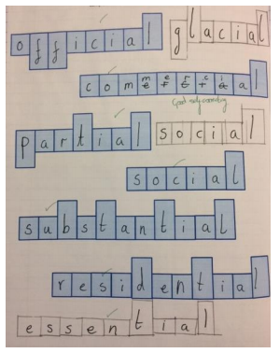
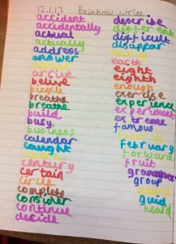
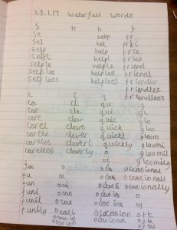
Spellings
FamilyID=Office_ArchiveTorn

Slide 19
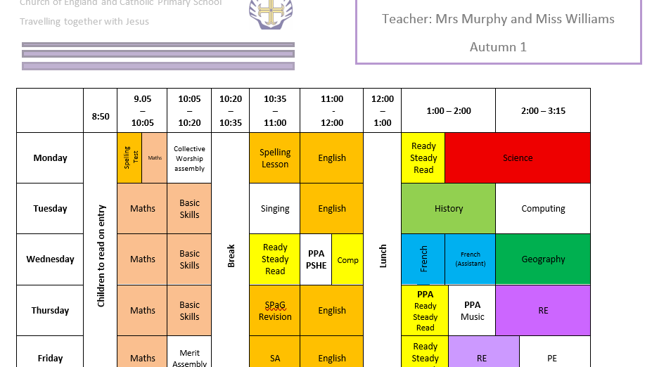

Slide 20

🏃‍♀️ Year 4 PE Kit – What Your Child Needs
To help your child enjoy PE lessons comfortably and safely, please make sure they have the following kit in school:
Indoor PE:
Plain white T-shirt
Black shorts
Black pumps
Outdoor PE:
Trainers
In colder weather, children may also wear:
  Emmaus navy blue sweatshirt
  Emmaus navy blue jogging bottoms
🛍️ Where to Buy:
You can buy the PE kit from Brienda.
📲 Forgotten Kit:
If your child forgets their PE kit, we’ll send a text message home and make a note of it to help us keep track.

Slide 21


Collective Worship and PSHE
CW Themes:
Generosity
Compassion
Courage
Forgiveness
Friendship
Respect
💬 PSHE in Year 4
We have a weekly PSHE lesson where children explore important topics that help them grow socially and emotionally.
Some of the areas we cover include:
Building and maintaining friendships
Working together as a team
Staying safe online
Understanding self-image and confidence
In the Summer Term, we also have one lesson where children learn the correct names for body parts, as part of our age-appropriate health education. These lessons are designed to be thoughtful, respectful, and supportive of every child’s development.

Slide 22


👔 Emmaus School
Uniform
To help all children feel part of our school community, we ask that they wear the correct uniform each day.
Uniform:
White shirt
School tie
Grey skirt or pinafore, or grey shorts/trousers
Grey socks with shorts/trousers
Grey socks or grey tights with skirt/pinafore
School jumper or cardigan
Black, plain school shoes
  No trainers or trainer-style shoes
  No logos or coloured details
Thank you for helping us maintain high standards and a sense of pride in our school.

Slide 23
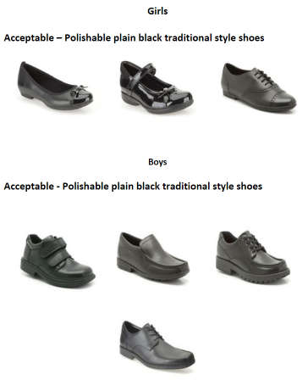


Shoes

Slide 24
🥦 Healthy Snacks & Packed Lunches at Emmaus
To support healthy habits and keep everyone safe, we kindly ask parents to follow these guidelines:
Snacks:
Children may bring fruit or vegetables only for their morning snack.
Packed Lunches:
Please do not include:
  Chocolate
  Sweets
  Crisps
  Fizzy drinks
Drinks:
Children may bring a water bottle (clearly labelled with their name)
Bottles can be refilled during the school day
🚫 Nut-Free School:
We are a NUT FREE school.
Please check all items in your child’s packed lunch to ensure they do not contain nuts.
Thank you for helping us keep all children healthy and safe

Slide 25

🏕️ Year 4 PGL Residential – Important Information
Wednesday 29th April to Friday 1st May 2026

Slide 26
🏕️ Year 4 PGL Residential – Important Information
We’re thrilled to offer the children an exciting PGL residential trip this year! It’s a brilliant opportunity for them to grow in confidence, try new things, and make lasting memories with their friends.
📅 Trip Details:
Dates: Wednesday to Friday (3 days, 2 nights)
Departure: Wednesday morning – we’ll arrive in time for lunch (provided by PGL)
Return: Friday at 3:15pm, ready for home time
💷 Cost:
The total cost of the trip is £240
A deposit is due by 30th September so we can confirm numbers with PGL
🧗‍♀️ Activities:
Children will take part in 5 activities per full day:
  2 in the morning
  2 in the afternoon
  1 in the evening
Activities include a mix of high-adventure challenges and ground-level team games, all led by trained PGL staff

Slide 27
🏕️ Year 4 PGL Residential – Important Information
🛏️ Accommodation:
Children sleep in bunkbeds, with 4 to 12 children per room
Rooms and activity groups are usually mixed from both Year 4 classes
Children will need to bring a sleeping bag and a pillow
🗓️ Parent Meeting:
We’ll be holding a parent information meeting in April to share more details, answer questions, and go through what to expect.
We’ll also send out a kit list and payment schedule soon.
If you have any questions in the meantime, please don’t hesitate to get in touch.

Slide 28
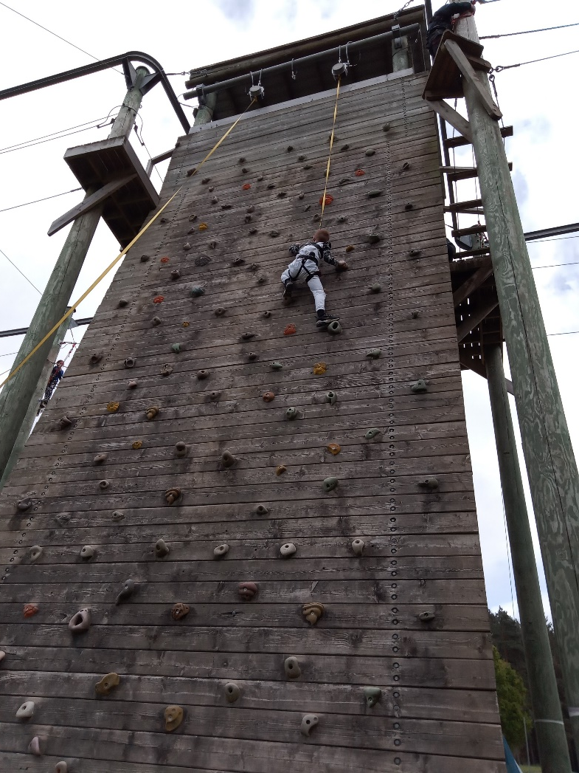
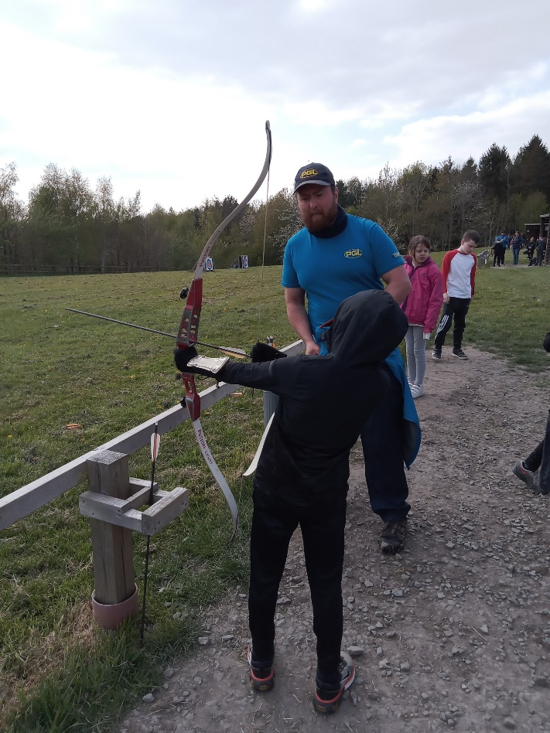
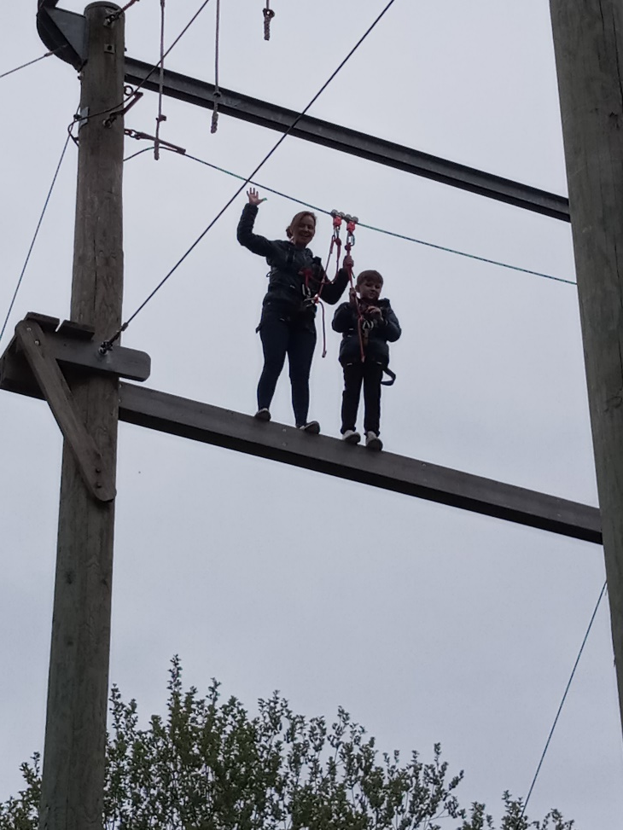
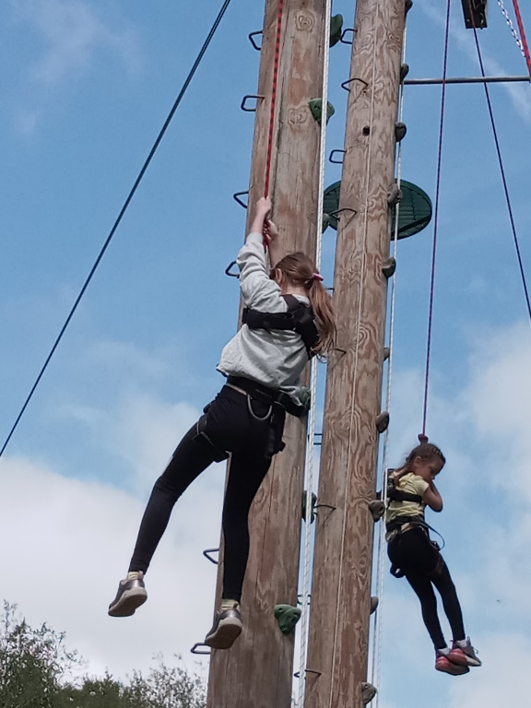
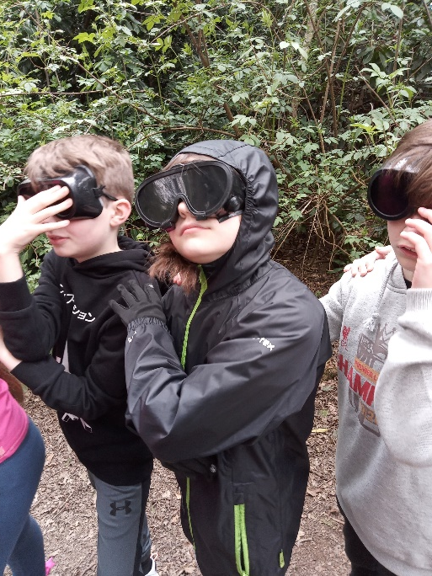
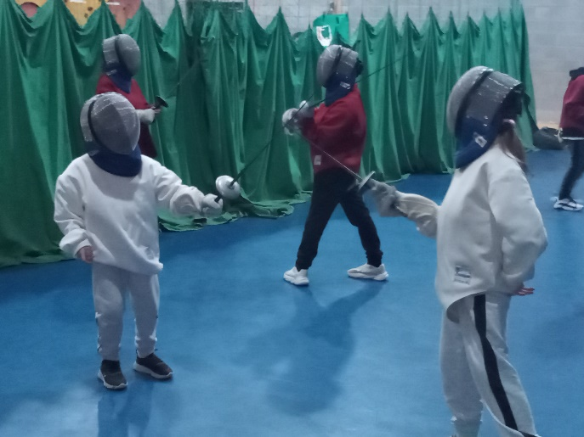
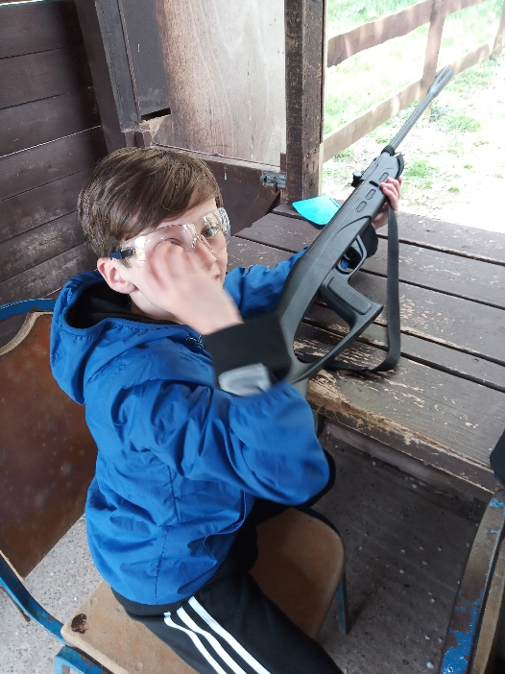

Slide 29

Thank you for listening!

