Slide 1
Welcome: Meet the teacher
September 2025
Points we will cover:
- The importance of attendance
- Reading
- Uniform
- Snacks
- Christian Values
- Curriculum & enrichment
- Staff
- Behaviour policy
The slides to this meeting will be available on our school website for you to access and read at your leisure.

Slide 2

Attendance Matters At Emmaus
Please ensure your child arrives for school on time
Telephone school if your child is to be late or absent
For routine non-emergency medical and dental appointments please ensure they are made outside of school hours
Contact school preferably by 9 am on the first day of absence if your child is unable to attend through illness.
If a text message/phone call is received as a result of your child’s absence it is important that you respond to this text to ensure your child is appropriately safeguarded.
Contact Mrs Hope (Attendance Lead) or Mr Williams (Headteacher) if the reason for absence requires a more personal contact.
Holidays in term time will not be authorized and will result in a fine

Slide 3

Reading opens so many opportunities
The Top Ten Benefits of Reading for Children
Their vocabulary is larger and more extensive.
They perform better academically.
Their imagination can run wild.
Their creativity skills develop.
They develop empathy.
They gain a deeper understanding of their world.
Their concentration levels improve.
The parent and child bond improves.
Their cognitive development is supported.
Their social skills and interaction improve.

Slide 4
Reading is KEY to Progress across the curriculum
If you read with your child at home, then you are supplementing what they learn in the classroom as well as giving them additional one-on-one support that the classroom cannot always give.
To have successful and effective reading sessions, consider the following:
Make it part of your routine.
Encourage variation of books.
Have patience with your child.
Continue the discussion after you have read the story.
If reading is something you require support with, please let me know. I will do my very best to support parents in any way I can.

Slide 5
Christian Values – please read at your leisure
At the very heart of what we do at Emmaus is our Christian Values
We are committed to creating a school based on the values of the Gospel, in which the traditions of the Anglican and Roman Catholic Churches are valued and affirmed by the whole community.
Developing an inclusive environment where the individual talents of each member of the school community are valued and nurtured.
Fostering within the school community, a sense of commitment and responsibility, respecting others and oneself.
Delivering a broad and balanced curriculum which both challenges and supports the diverse needs of each individual

Slide 6
Teachers and support staff and other adults working in 2W
Miss Walker – Class Teacher
Mrs Hunstone – Learning Support Assistant
Mrs Boylan – 1:1 Support
WE VERY MUCH WORK AS A TEAM IN Year 2 so although the staff above are in 2W the children will also have access to support from our teacher and staff in 2M to support learning and if children in classes need to talk through any worries.
We encourage all our children to have a voice if they are worried and signpost them to all the adults in Year 2 and staff at lunchtimes and playtime.

Slide 7
Behaviour policy
Key Stage 1 and 2 Consequences
Verbal warning
Name on the board
Cross put beside child’s name and 5 minutes playtime lost
Another cross by child’s name, all playtime lost and sent to the parallel Teacher, parents contacted by the teacher
Child referred to Senior Leadership Team member and parents contacted by SLT and Behaviour Plan agreed all parties.

Slide 8
Topics -Geography
Continents & Oceans Name and locate the 7 continents and 5 oceans, use geographical language, use locational and compass language to describe features and routes on a map
Hot & Cold Places Recognising geographical similarities and differences between hot and cold places, weather patterns and some continents and oceans work.
Virtual Fieldwork activities
Our local area Recognising and studying human and physical Geography features in Liverpool. Use aerial photographs to recognise landmarks and physical features. Fieldwork study of our school, Croxteth Park & surrounding areas.

Slide 9
History – Visits and school trips
Significant Individuals & Local History Comparing Florence Nightingale with Mary Seacole
The Great Fire of London- How do we know about the events of The Great Fire:
Altru: Drama company to tell this historical event
To retell and bring alive this important historical event.

Slide 10
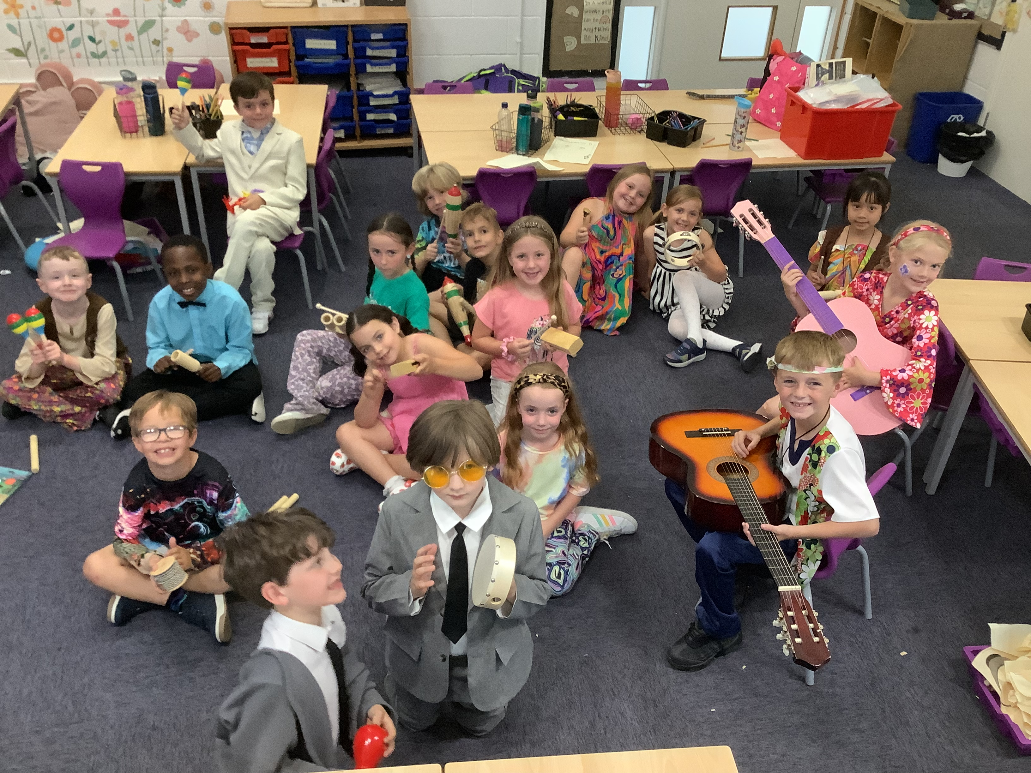
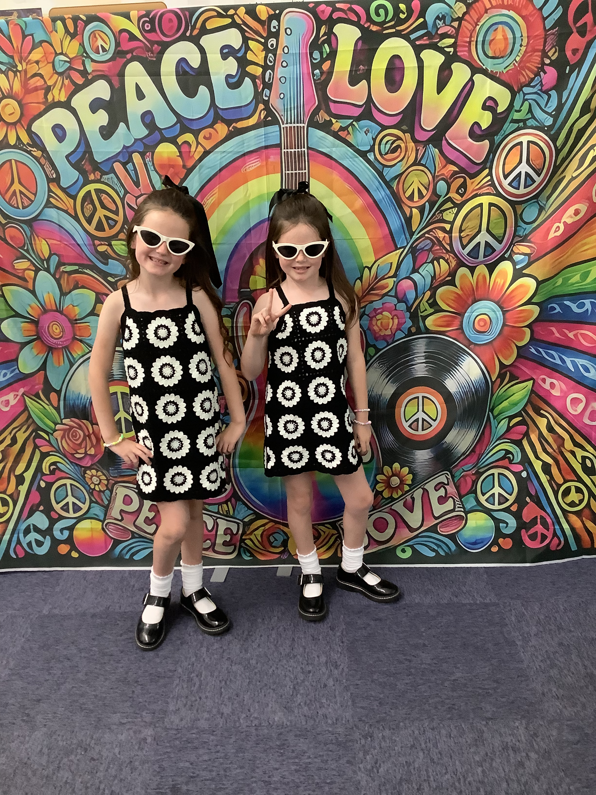
History – Visits and school trips
The Beatles Why is Liverpool airport called John Lennon airport?
Beatles Day:

Slide 11
Science
Animals including Humans:
Exploring the world around us by raising our own questions about:
Healthy living: food, exercise and hygiene. Life processes: what animals and humans need to survive & reproduction and growth of offspring to adults, basic life cycles
Plants:
Plants Observing and describing how seeds and bulbs grow into mature plants noting what plants need to stay healthy. Germination, growth & survival Reproduction of plants Setting up comparative tests to show how plants need light and water to stay healthy
Growing our own plants
Living things and their habitats
What is living, dead, never alive Adaptations of animals Investigating micro-habitats Food chains Food sources
Dylan’s Reptiles – children get to explore different reptiles, habitats and diet. The children will have the opportunity to handle the reptiles, pictures of this will be added to the website.
Uses of everyday materials
Identifying materials and their properties, explain suitability for uses of materials, inventors of materials, changing shape of materials

Slide 12
Uniform
https://www.emmausschool.co.uk/school-uniform/
Timetable for PE
Tuesday AM
Please note a text will be sent home if your child does not bring in their PE kit.
Please make sure your child has their full kit in school every week and please label all belongings so if anything is misplaced it can be found quickly.

Slide 13
Homework
Homework will be given out every Friday and must be returned on Wednesday the following week.
Homework will include mathematics and spelling piece of work and occasionally work linked to a theme we are covering in our foundation subjects.
Some homework will be to practise a skill or talk homework.
RWInc
Read, write inc books will be sent home daily and will need to be returned daily so children can be monitored for reading and supported.
RWInc groups change half termly depending on your child’s progress, please be aware this could be with a different teacher in a different room.

Slide 14
Healthy snacks and drinks
Piece of fruit or vegetable only
Children must not bring in chocolate or crisps for their morning snack
No fizzy drinks are to be brought in packed lunches or class
Children must only have water in their class water bottles.
Thank you

Slide 15
Please visit the website!!
https://www.emmausschool.co.uk/curriculum-subjects/
Overview of subjects
Photographs
Policies
RWI resources
Teacher email addresses – for emergency only
Please do not email if it can be discussed quickly on entry or at end of the school day.
Thank you

Slide 16

Questions
If you are unsure about anything or you remember something when you go home, again have a chat with a member of the Year 2 Team and we will be happy to help.
SATs will continue for Year 2 children at Emmaus. However, they are used only to inform/ support teacher assessments.
They will be taken in test conditions outside the classroom, and the children will be made aware that the tasks are part of their ‘Special Work’
Your children will be assessed by their class teacher against the standards set by local government
Your children are simply awesome so we have no concerns about how well they will learn, progress and enjoy year 2.

